Slide 1
Building Accelerated Applications with Vitis
Course Workbook

Slide 2
Table of Contents
About this Workbook | Page 3
Pre-Lab: Workshop Pre-requisites | Page 4
Lab 1: Understanding Vitis Project creation & Flow | Page 7
Lab 2: Instantiating Xilinx Deep Learning Processor | Page 48

Slide 3
About this Workbook
This workbook is designed to be used in conjunction with the Building Accelerated Applications with Vitis course.
The contents of this workbook are created by Adiuvo Engineering & Training, Ltd.
If you have any questions about the contents, or need assistance, please contact Adam Taylor at adam@adiuvoengineering.com.

Slide 4
Pre-Lab Workshop Pre-requisites

Slide 5
Required Hardware
Pre-Lab
There is no required hardware for this course.

Slide 6
Downloads and Installations
Pre-Lab
Step 1 – Download and install the following at least 1 day prior to the workshop. This may take a significant amount of time and drive space.
Watch the video available here to show how to configure the installation
Vitis 2020.1 | Download
XRT | Download
Embedded Platforms | Download
Common Images for Embedded Platforms | Download

Slide 7
Lab 1 Understanding Vitis Project creation & Flow

Slide 8
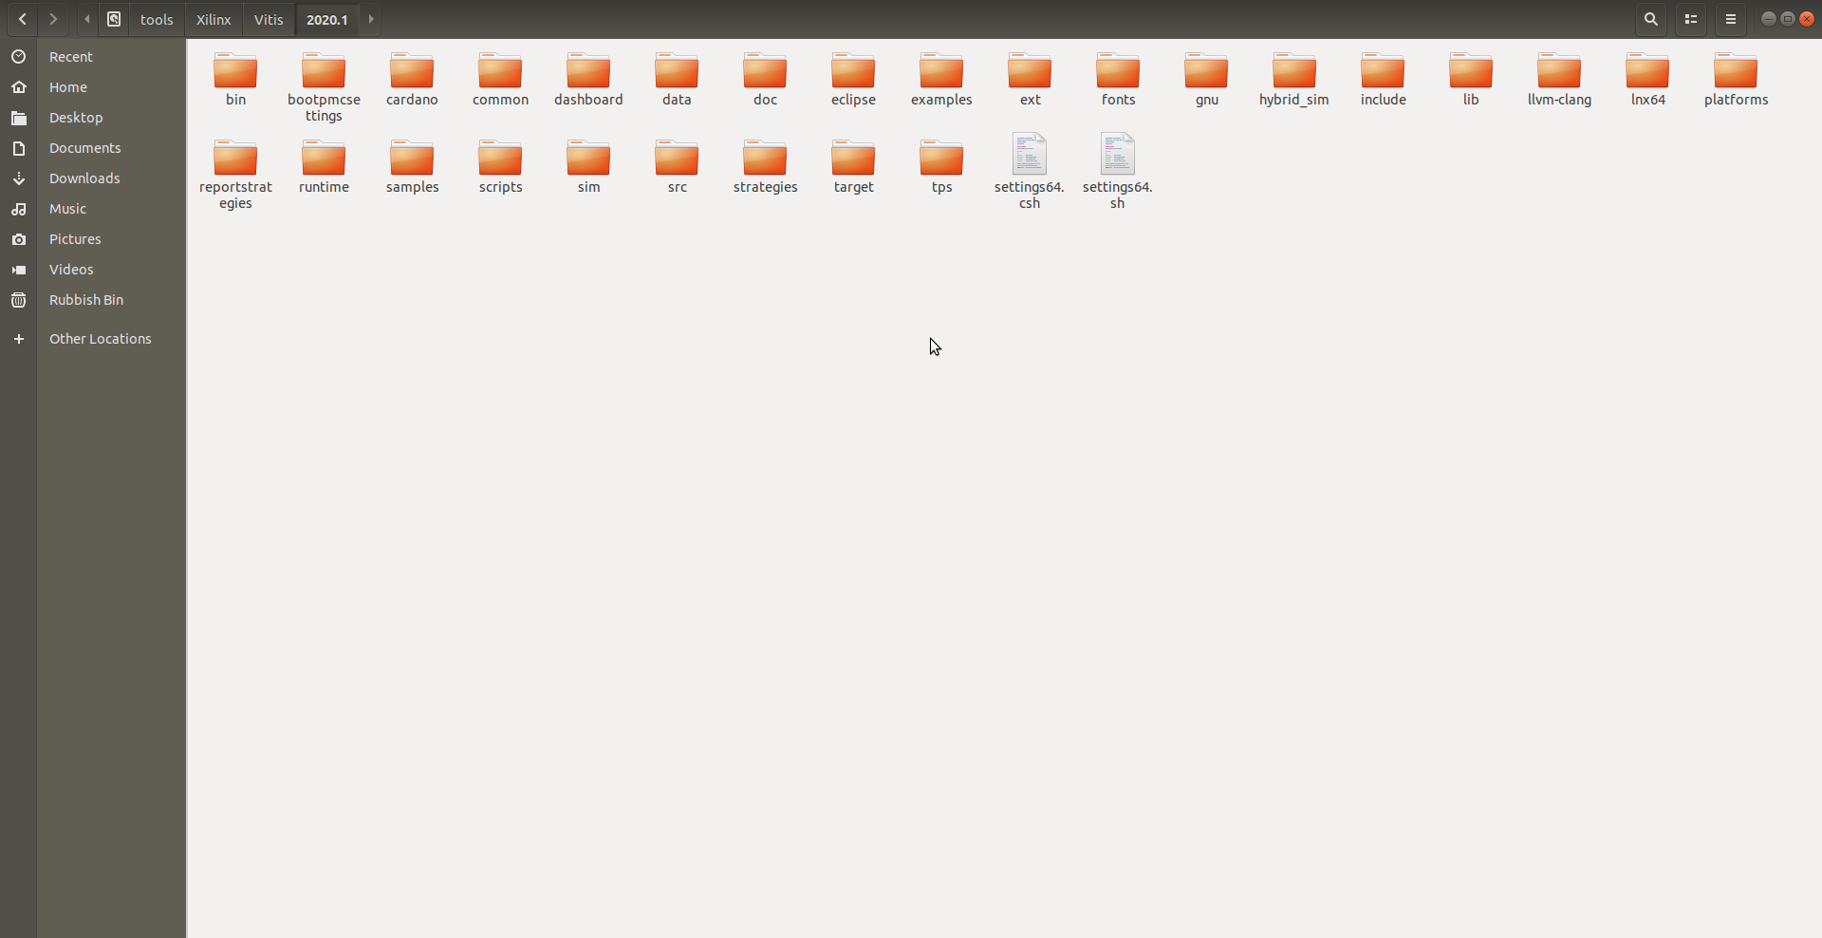
Lab 1: Understanding Vitis Project creation & Flow
Lab 1
Step 1 – Open a file browser and navigate to /tools/Xilinx/Vitis/2020.1

Slide 9
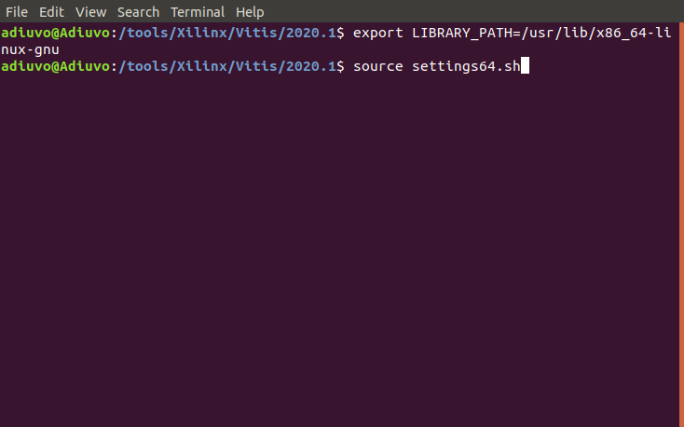
Lab 1: Understanding Vitis Project creation & Flow
Lab 1
Step 2 – Open a terminal window, set the path of the LIBRARY_PATH and source the settings64.sh
export LIBRARY_PATH=/usr/lib/x86_64-linux-gnu

Slide 10
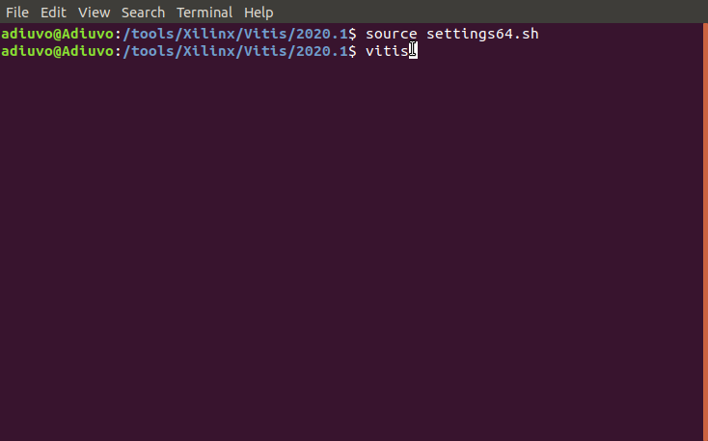
Lab 1: Understanding Vitis Project creation & Flow
Lab 1
Step 3 – Start Vitis from the command prompt by typing “vitis”

Slide 11
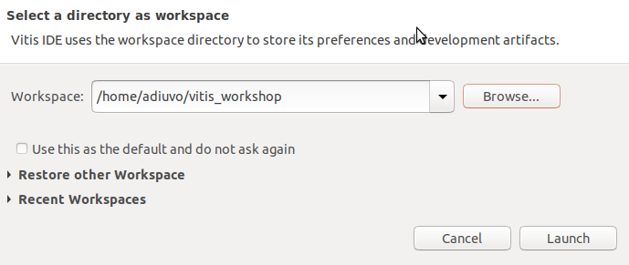
Lab 1: Understanding Vitis Project creation & Flow
Lab 1
Step 3 – Select the directory you which to use as your workspace, click launch

Slide 12
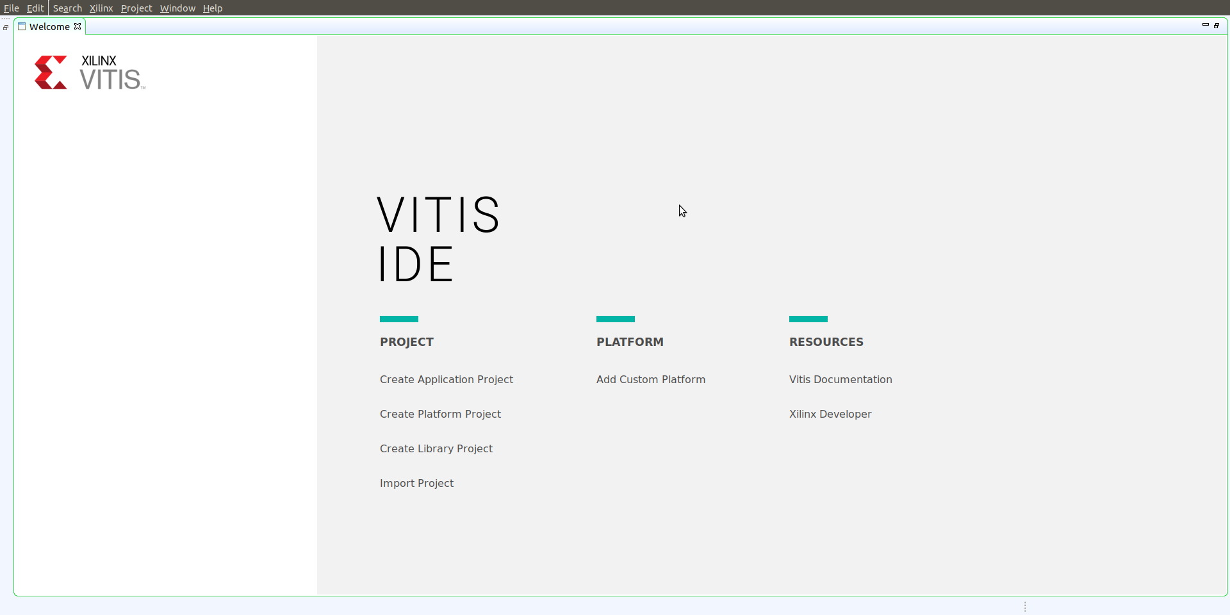
Lab 1: Understanding Vitis Project creation & Flow
Lab 1
Step 4 – When the IDE launches, select “Create Application Project”

Slide 13
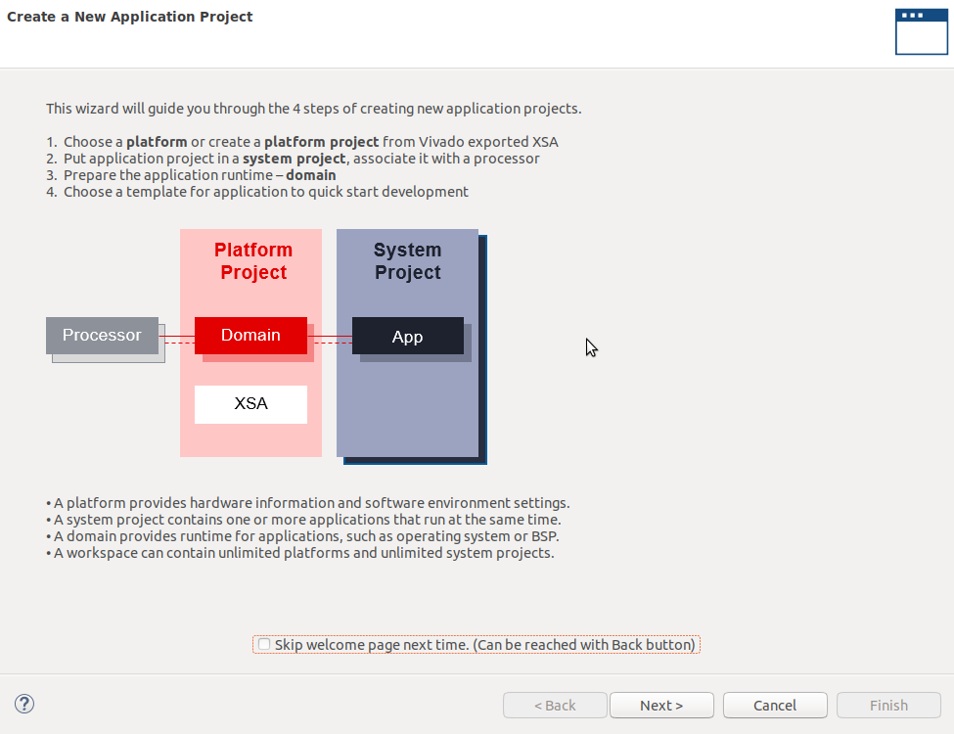
Lab 1: Understanding Vitis Project creation & Flow
Lab 1
Step 5 – This will launch the project creation wizard, click next on the first dialog

Slide 14
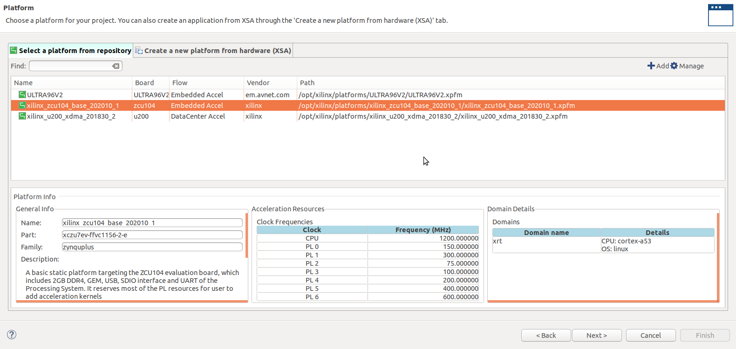
Lab 1: Understanding Vitis Project creation & Flow
Lab 1
Step 6 – You should see the platforms you installed; I will select ZCU104, click next

Slide 15
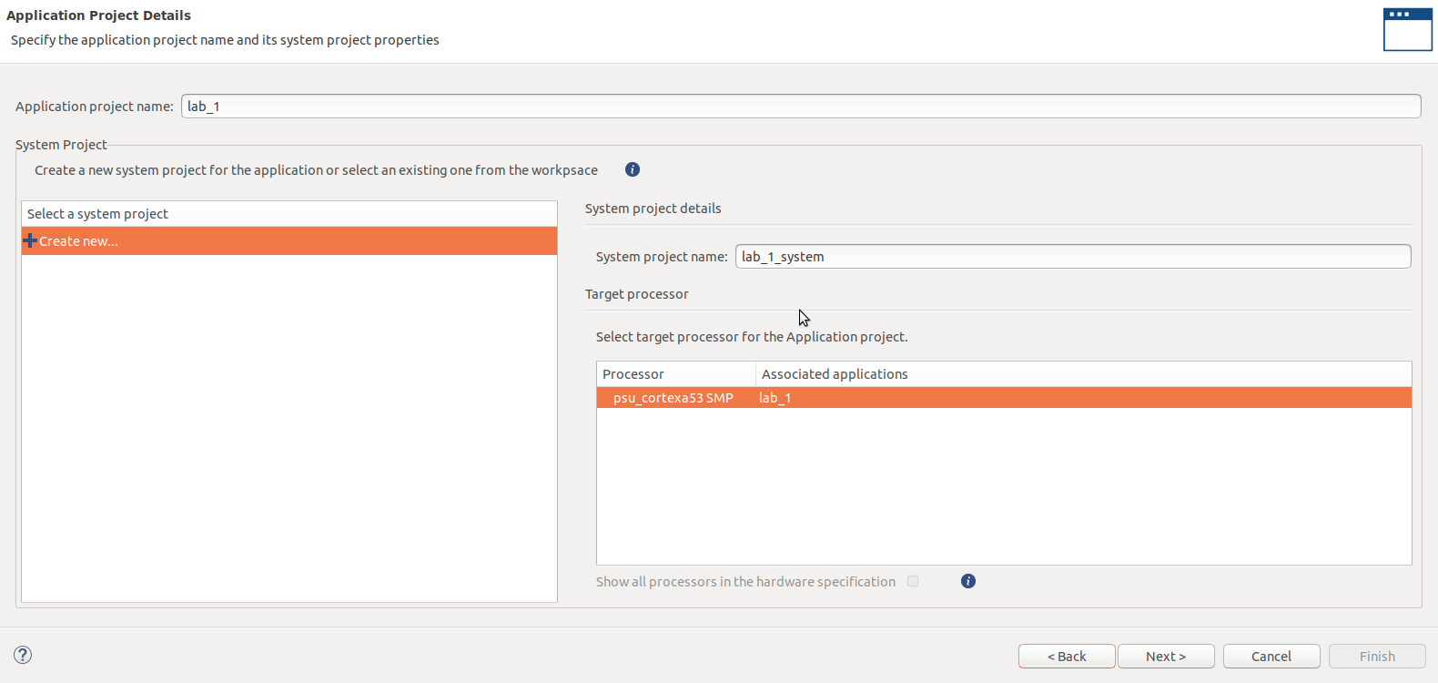
Lab 1: Understanding Vitis Project creation & Flow
Lab 1
Step 7 – Enter the name lab_1 for the project name and click next

Slide 16
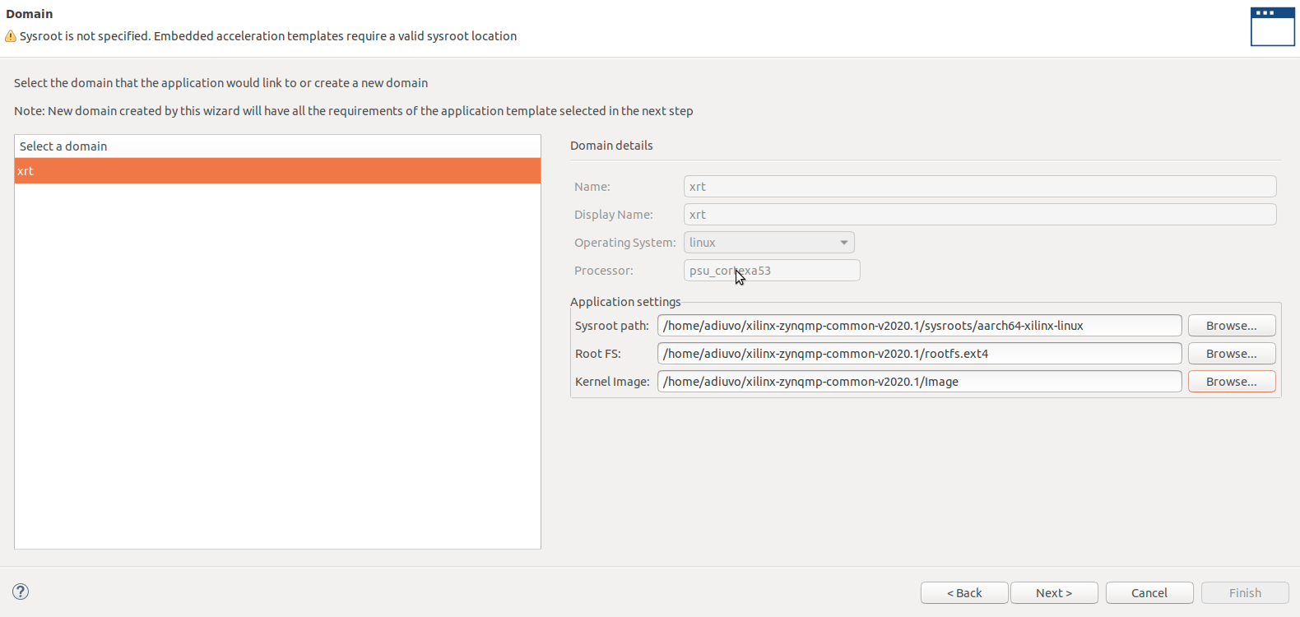
Lab 1: Understanding Vitis Project creation & Flow
Lab 1
Step 8 – Enter the Sysroot, Root FS and Kernel image previously installed, click next

Slide 17
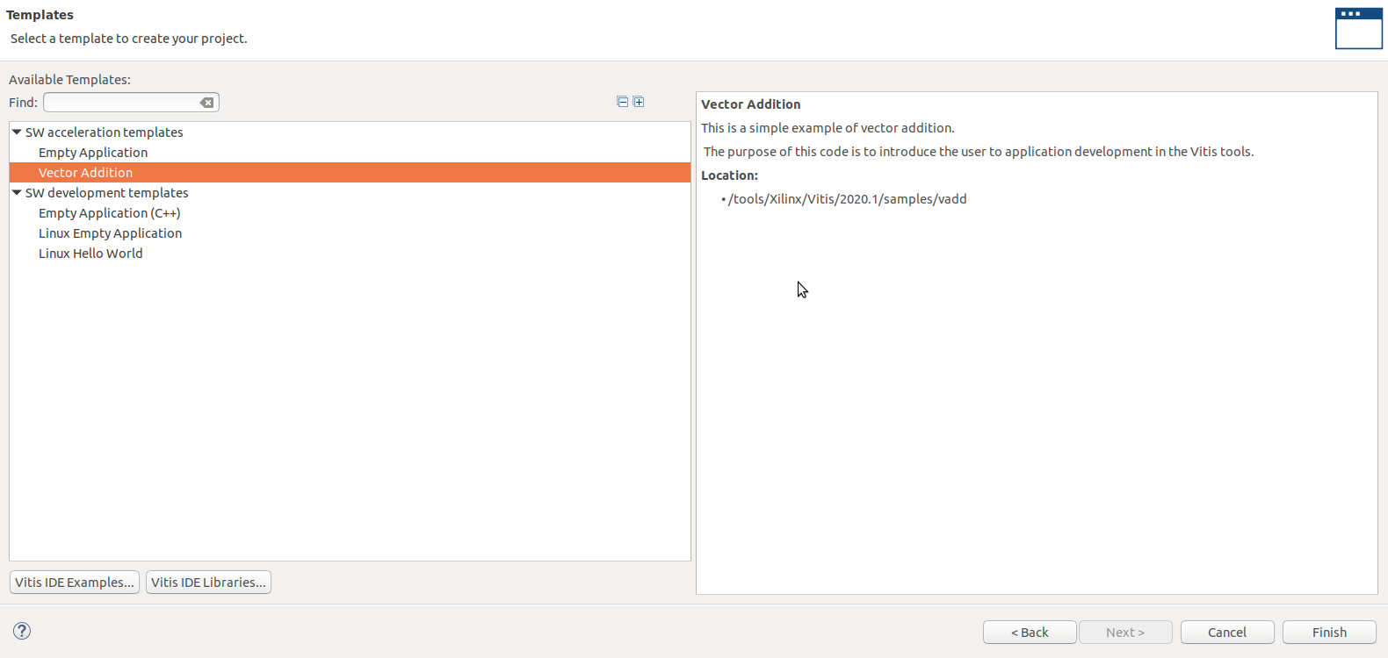
Lab 1: Understanding Vitis Project creation & Flow
Lab 1
Step 8 – Select the Vector Addition example and click finish

Slide 18
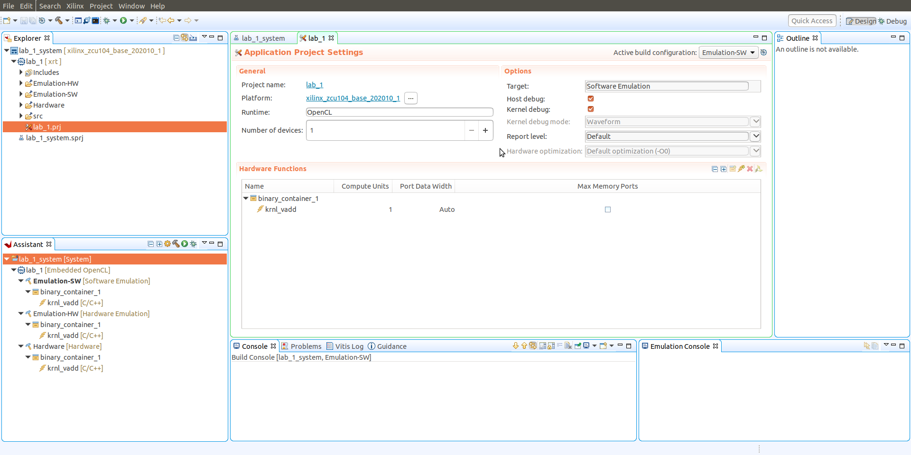
Lab 1: Understanding Vitis Project creation & Flow
Lab 1
Step 9 – This will open the project in the Vitis IDE

Slide 19
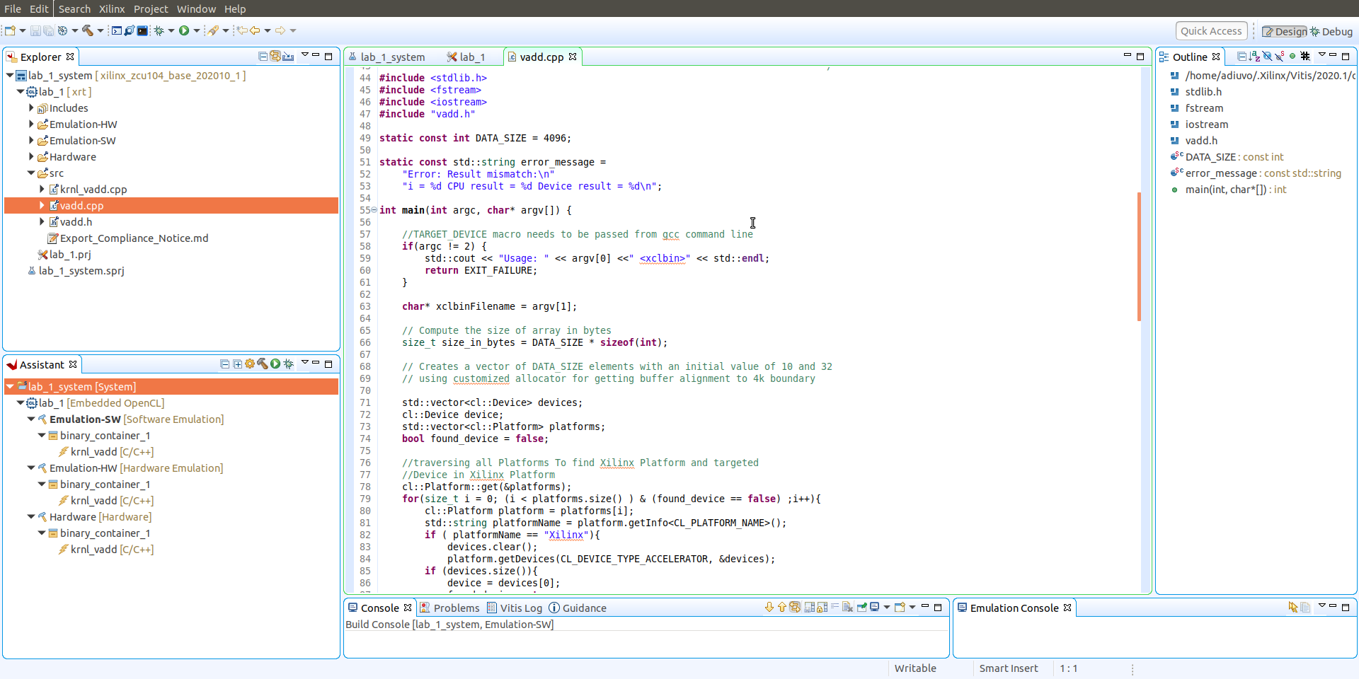
Lab 1: Understanding Vitis Project creation & Flow
Lab 1
Step 10 – Expand the src directory and double click on the Vadd.cpp file – this is the host SW

Slide 20
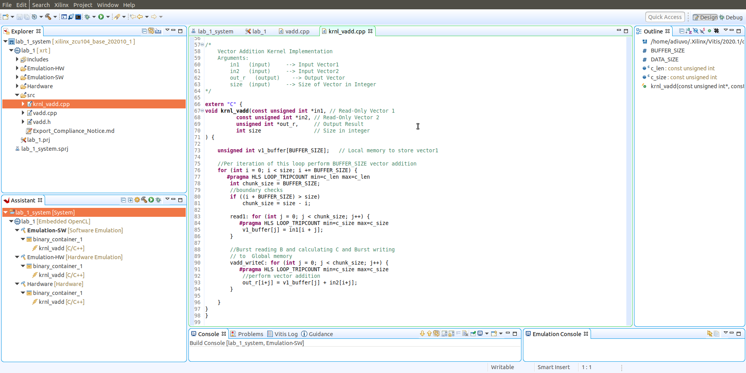
Lab 1: Understanding Vitis Project creation & Flow
Lab 1
Step 11 – Double click on the krnl_vadd.cpp file – this is the accelerator

Slide 21
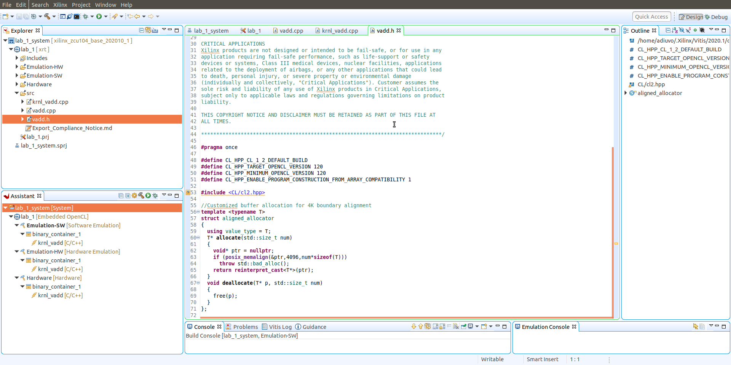
Lab 1: Understanding Vitis Project creation & Flow
Lab 1
Step 12 – Double click on the vadd.h

Slide 22
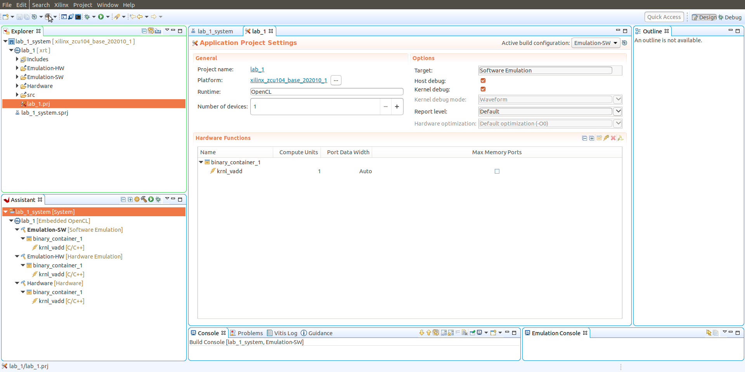
Lab 1: Understanding Vitis Project creation & Flow
Lab 1
Step 13 – Click on the lab_1 tab this where we set most configurations for building – make sure the active build configuration is set at Emulation-SW

Slide 23
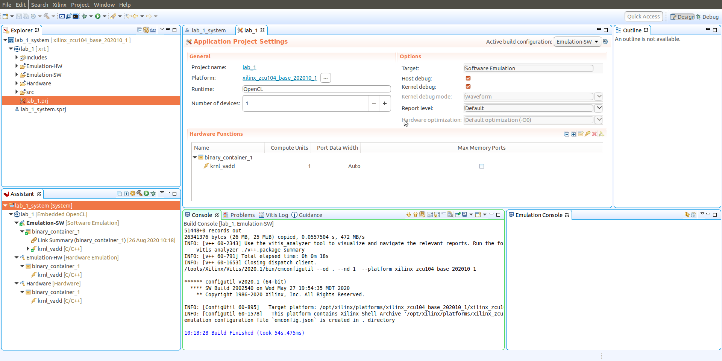
Lab 1: Understanding Vitis Project creation & Flow
Lab 1
Step 14 – Build the SW Emulation by clicking on the hammer

Slide 24
Lab 1: Understanding Vitis Project creation & Flow
Lab 1
Step 15 – Launch the debugger by right clicking on Emulation-SW and Launch on Emulator

Slide 25
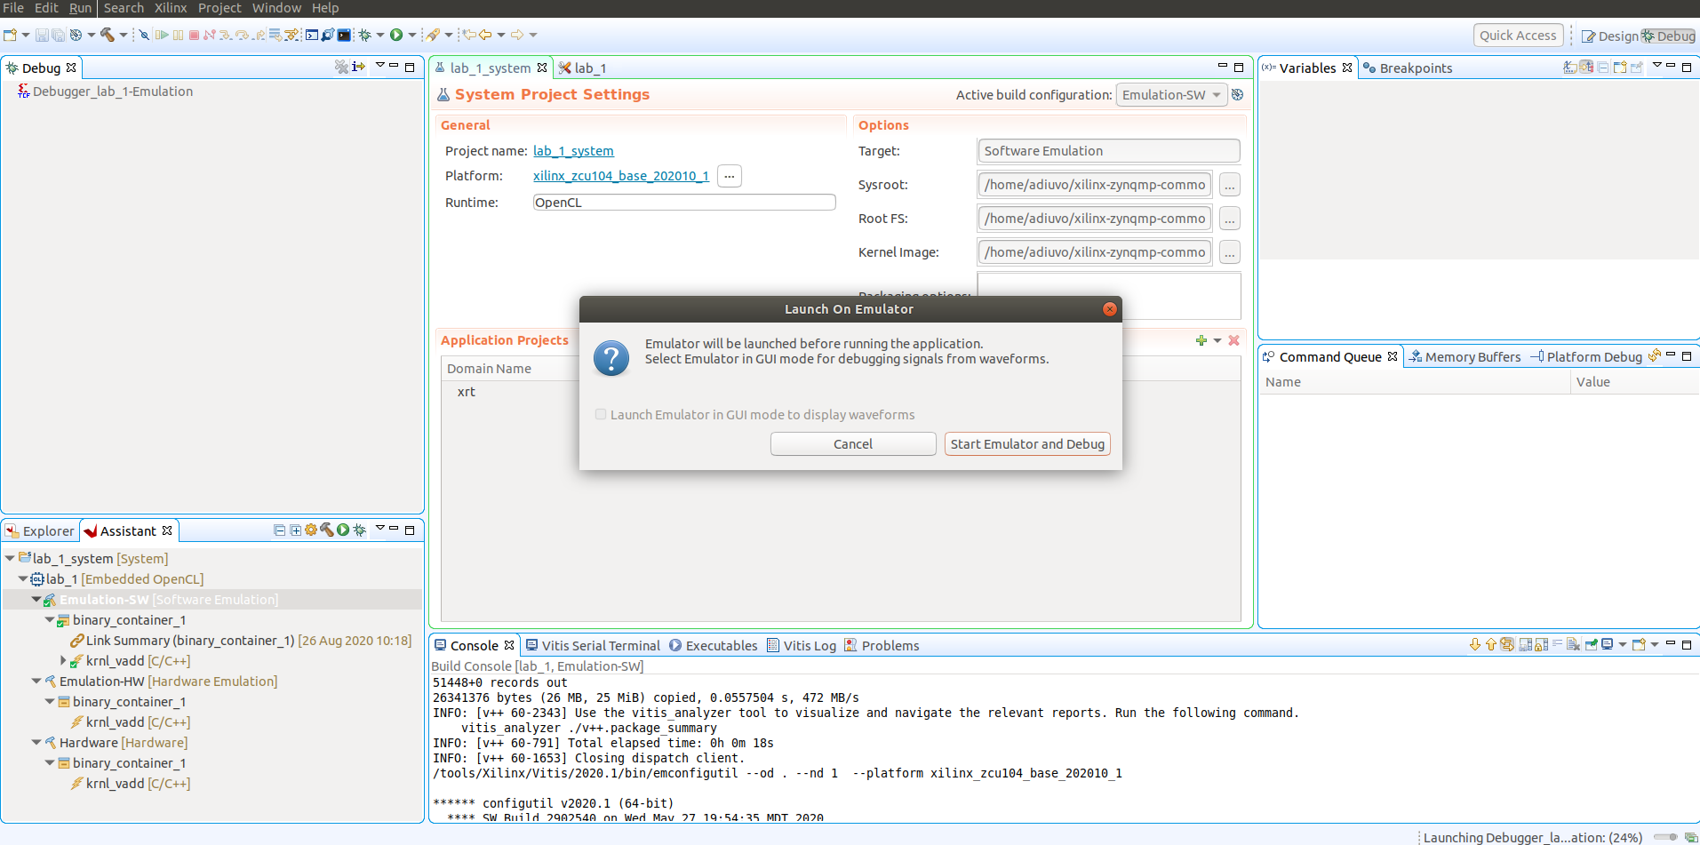
Lab 1: Understanding Vitis Project creation & Flow
Lab 1
Step 16 – This will open the Debug Perspective and click on start Emulator and Debug

Slide 26
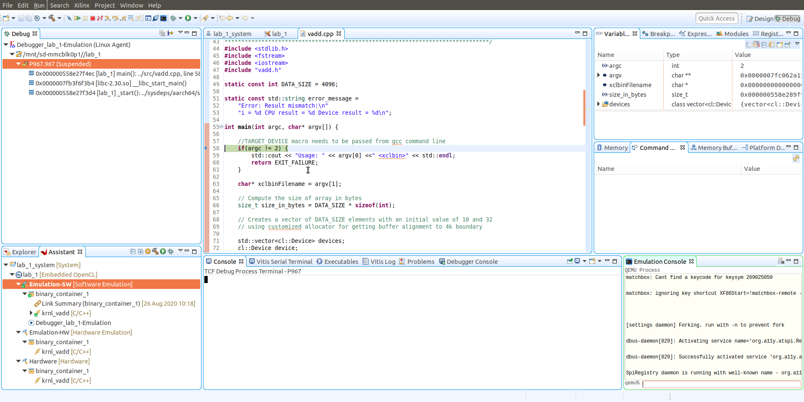
Lab 1: Understanding Vitis Project creation & Flow
Lab 1
Step 17 – Once the Emulator is loaded and the TCF agent connected the Host application will pause awaiting execution.

Slide 27
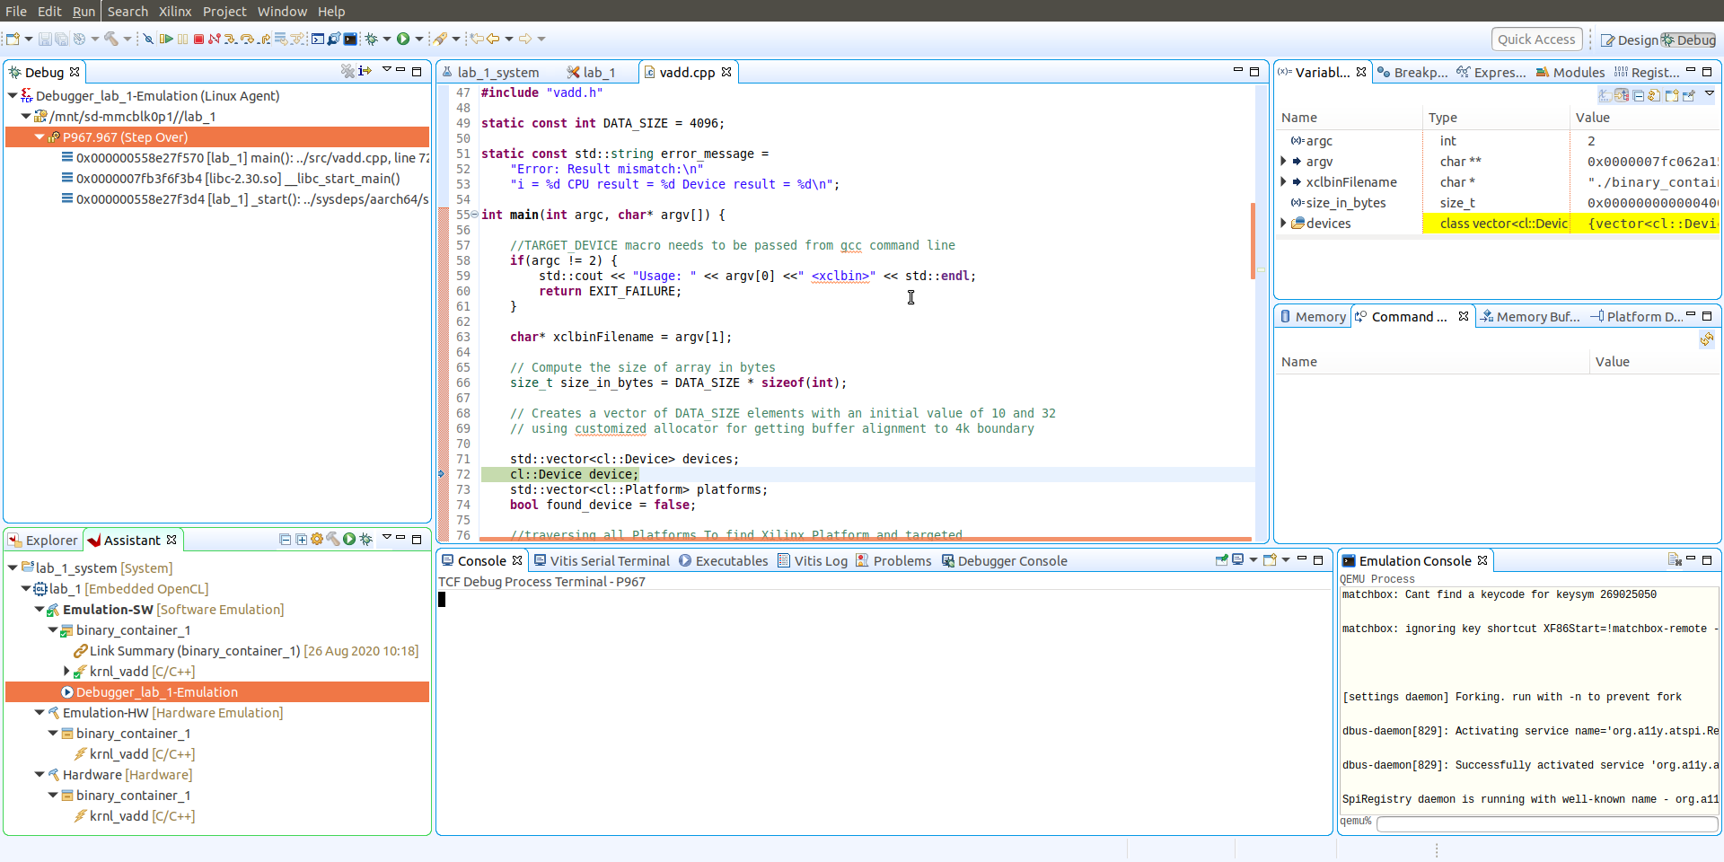
Lab 1: Understanding Vitis Project creation & Flow
Lab 1
Step 18 – Single step through a few instructions and see the variables update

Slide 28
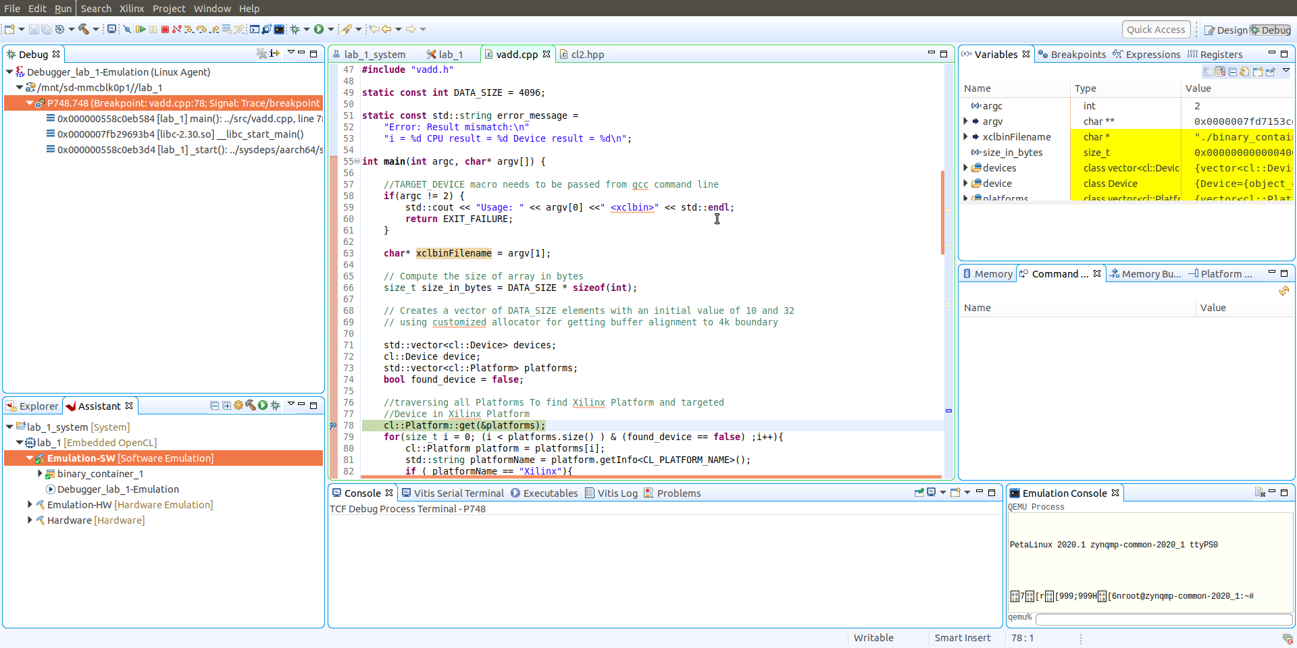
Lab 1: Understanding Vitis Project creation & Flow
Lab 1
Step 19 – Double click in the edge of the source code on line 78 to insert a breakpoint then select run, see the break point get hit and variables update. Clock on the red terminate button
Notes:
If there’s a problem here (with qemu/virtual machine) have them open a new terminal and do “netstat –v” and “sudo apt install net-tools”

Slide 29
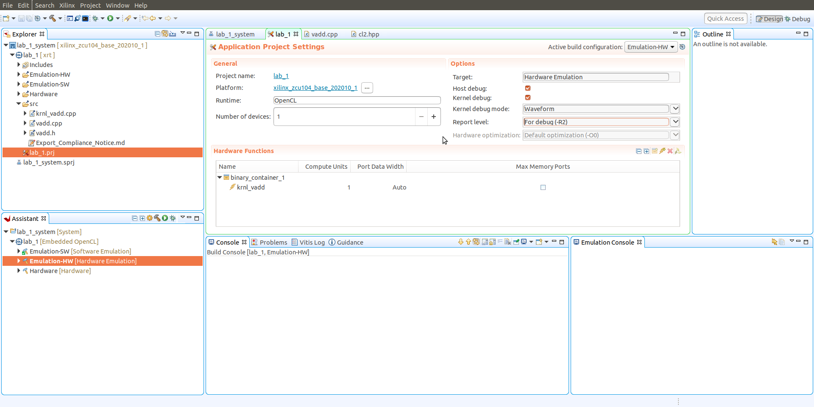
Lab 1: Understanding Vitis Project creation & Flow
Lab 1
Step 20 – Change the perspective back to design, set the active build configuration to Emulation-HW, Report Level to For-Debug and build the design

Slide 30
Lab 1: Understanding Vitis Project creation & Flow
Lab 1
Step 21 – Once build is complete, right click on Emulation-HW and launch a emulation debug session

Slide 31
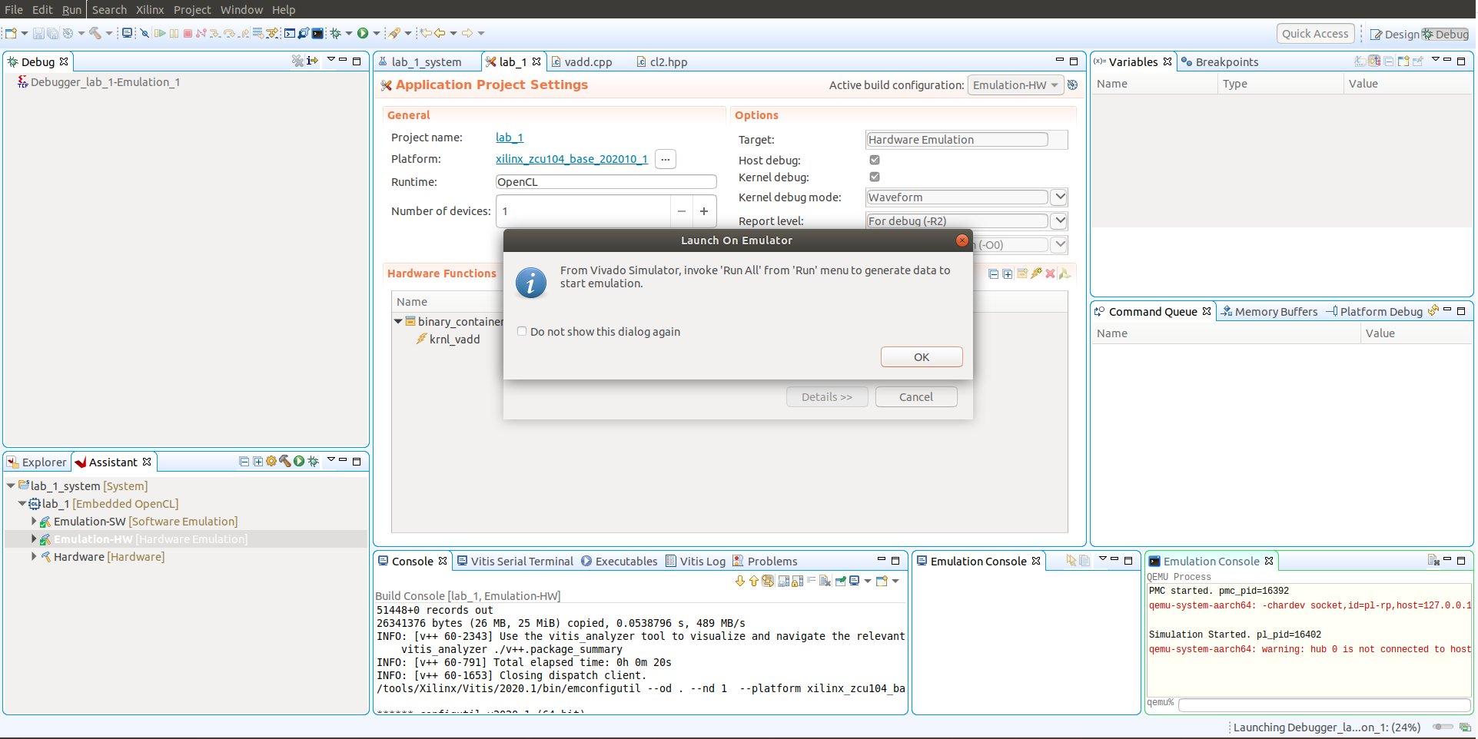
Lab 1: Understanding Vitis Project creation & Flow
Lab 1
Step 22 – This will launch Vivado, change views to Vivado when the dialog below appears
Notes:
If there are problems here (build fail – LIBRARY PATH: unbound) they need: export LIBRARY_PATH=/usr/lib/x86_64-linux-gnu in the same terminal session as vitis, but before invoking vitis

Slide 32
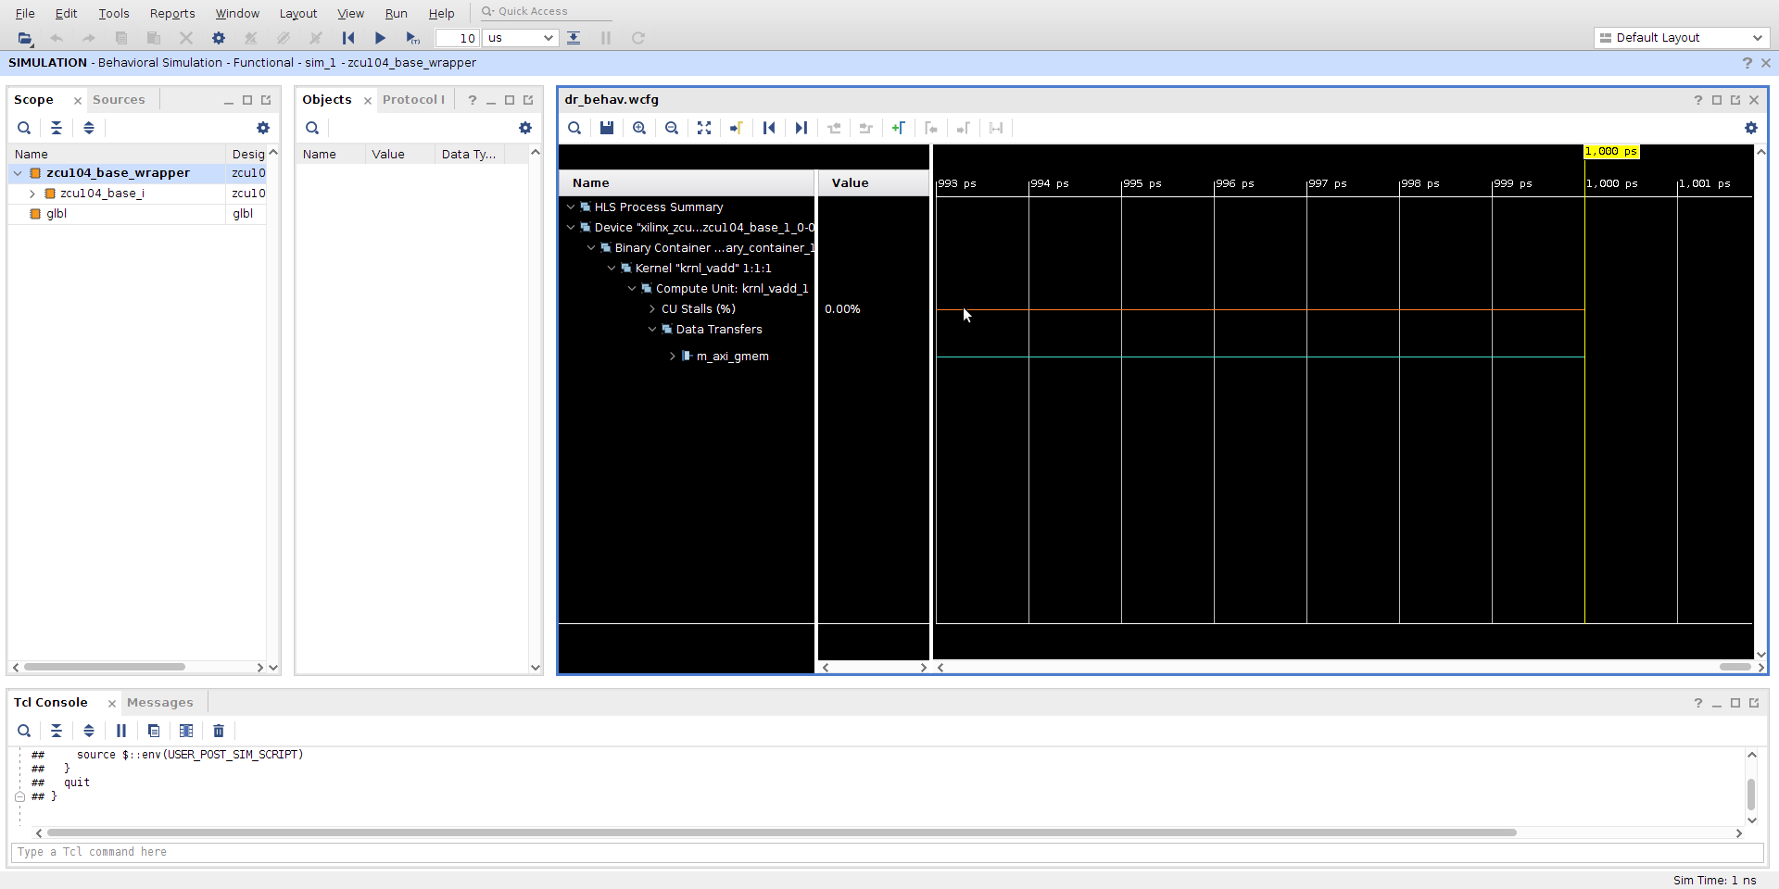
Lab 1: Understanding Vitis Project creation & Flow
Lab 1
Step 23 – Click on the run all button in Vivado and switch back to Vitis

Slide 33
Lab 1: Understanding Vitis Project creation & Flow
Lab 1
Step 24 – Click OK on the dialog

Slide 34
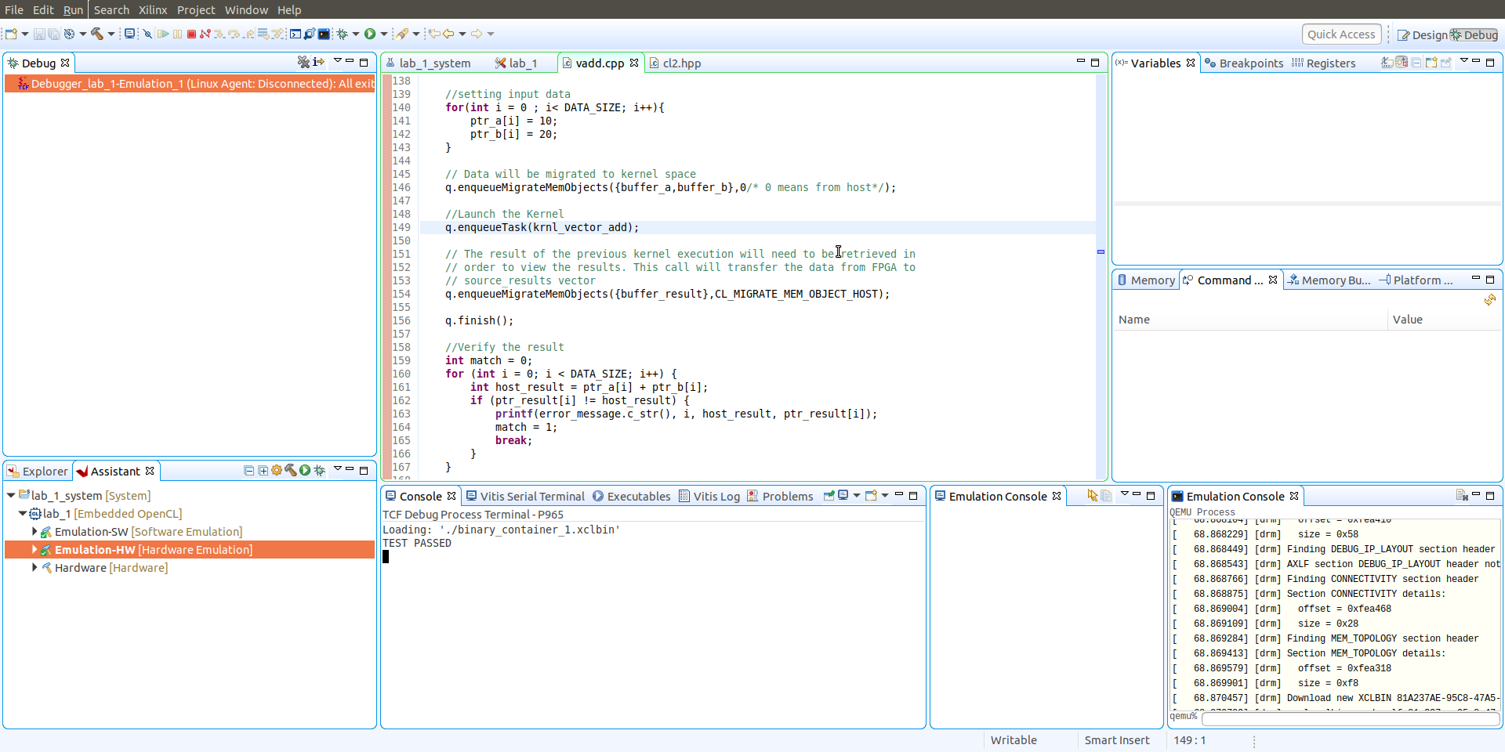
Lab 1: Understanding Vitis Project creation & Flow
Lab 1
Step 25 – When the Debugger loads, click Run and the Application will execute and should show a passed status, click on maximise in the Emulation Console

Slide 35
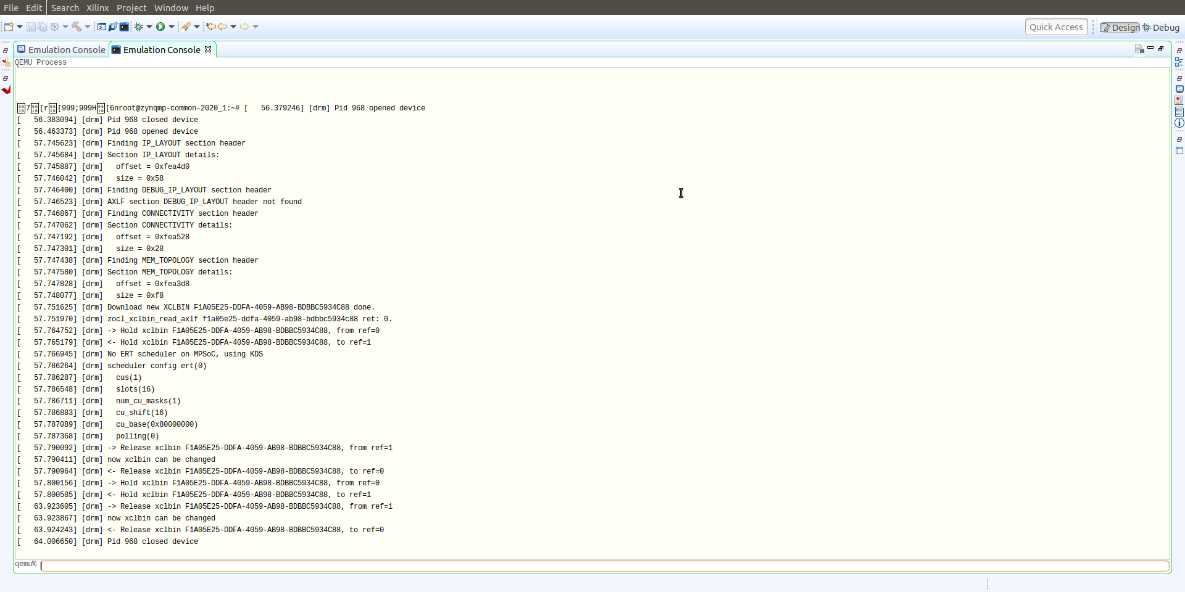
Lab 1: Understanding Vitis Project creation & Flow
Lab 1
Step 26 – In the Emulation console you will see the XCLBinary being loaded as you will on the real hardware.

Slide 36
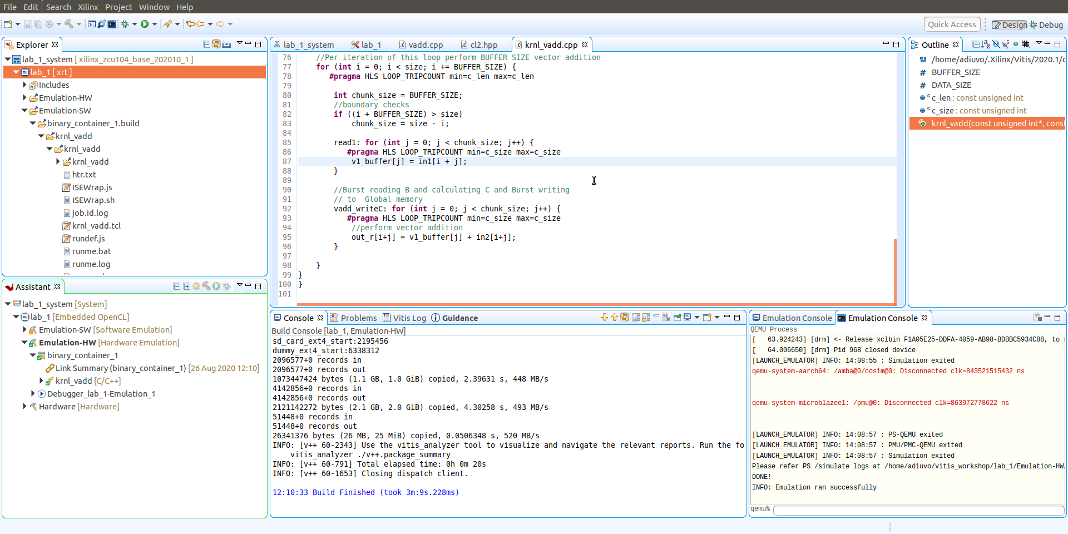
Lab 1: Understanding Vitis Project creation & Flow
Lab 1
Step 24 – Under the assistant view, Emulation hardware select the XCLBin, right click and open the Vitis Analyser.

Slide 37
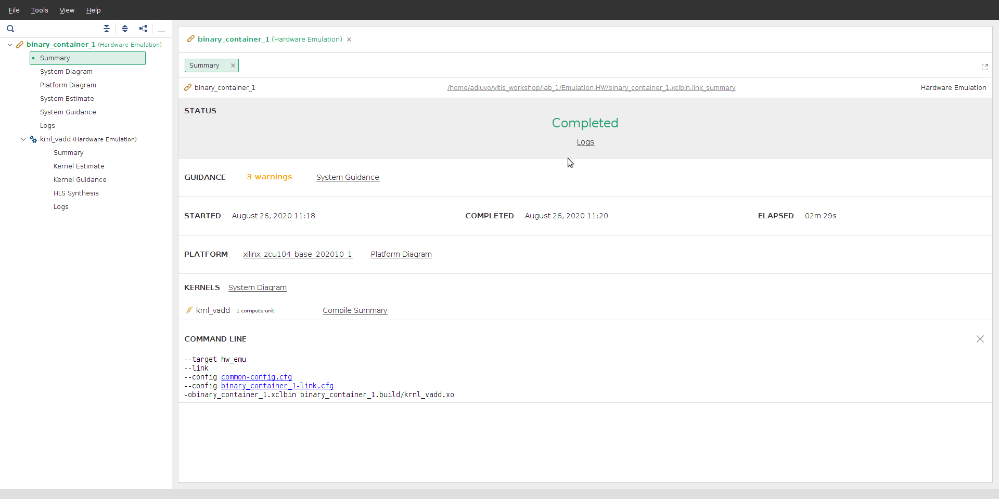
Lab 1: Understanding Vitis Project creation & Flow
Lab 1
Step 24 – The Vitis Analyzer will provide information on the System Performance and Accelerator performance.

Slide 38
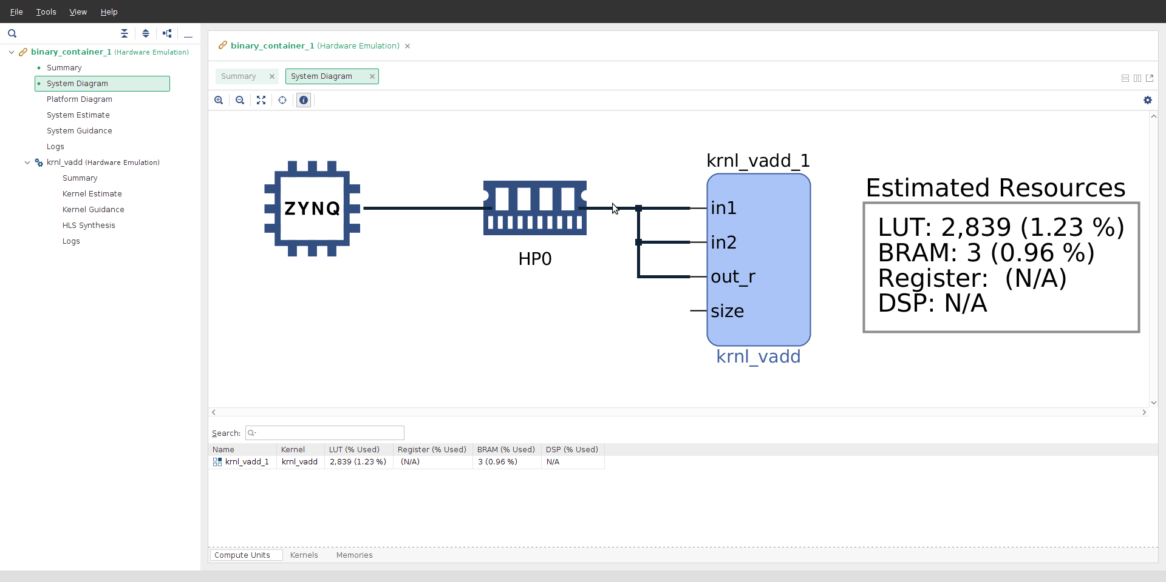
Lab 1: Understanding Vitis Project creation & Flow
Lab 1
Step 24 – Click on the System Design this will show how the accelerator is connected to the Host

Slide 39
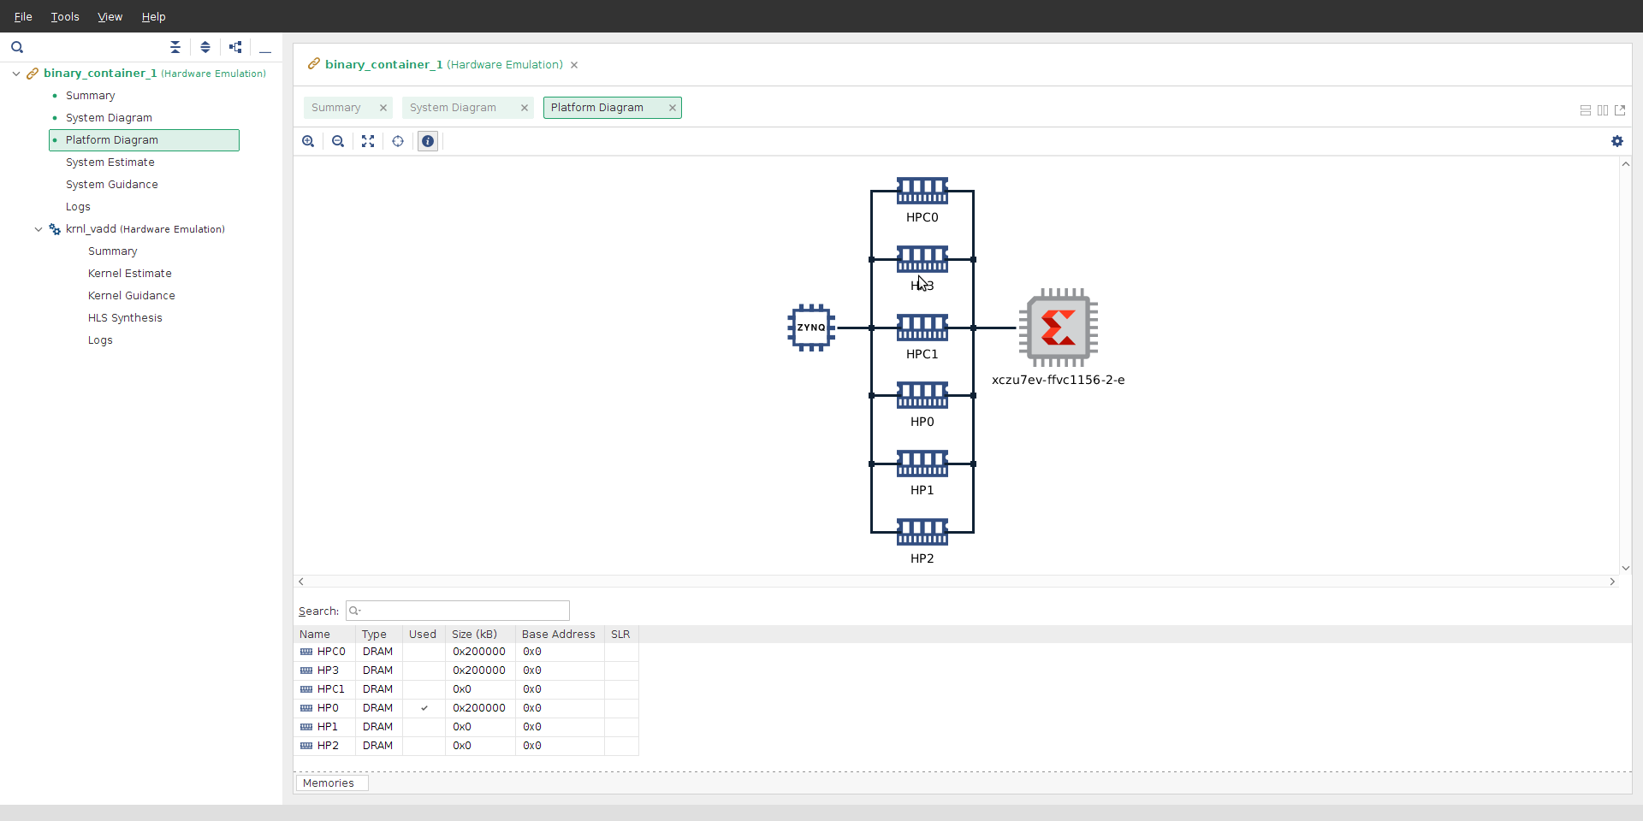
Lab 1: Understanding Vitis Project creation & Flow
Lab 1
Step 24 – Click on the Platform Diagram this will show the connections available in the system

Slide 40
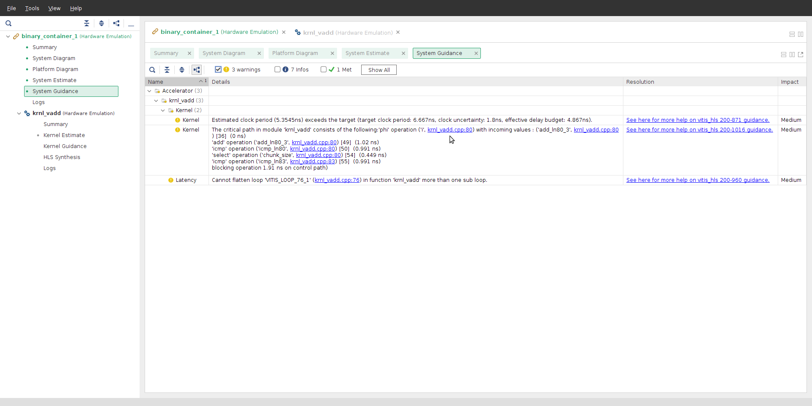
Lab 1: Understanding Vitis Project creation & Flow
Lab 1
Step 24 – Click on the System Guidance, this will report any warnings and resolutions

Slide 41
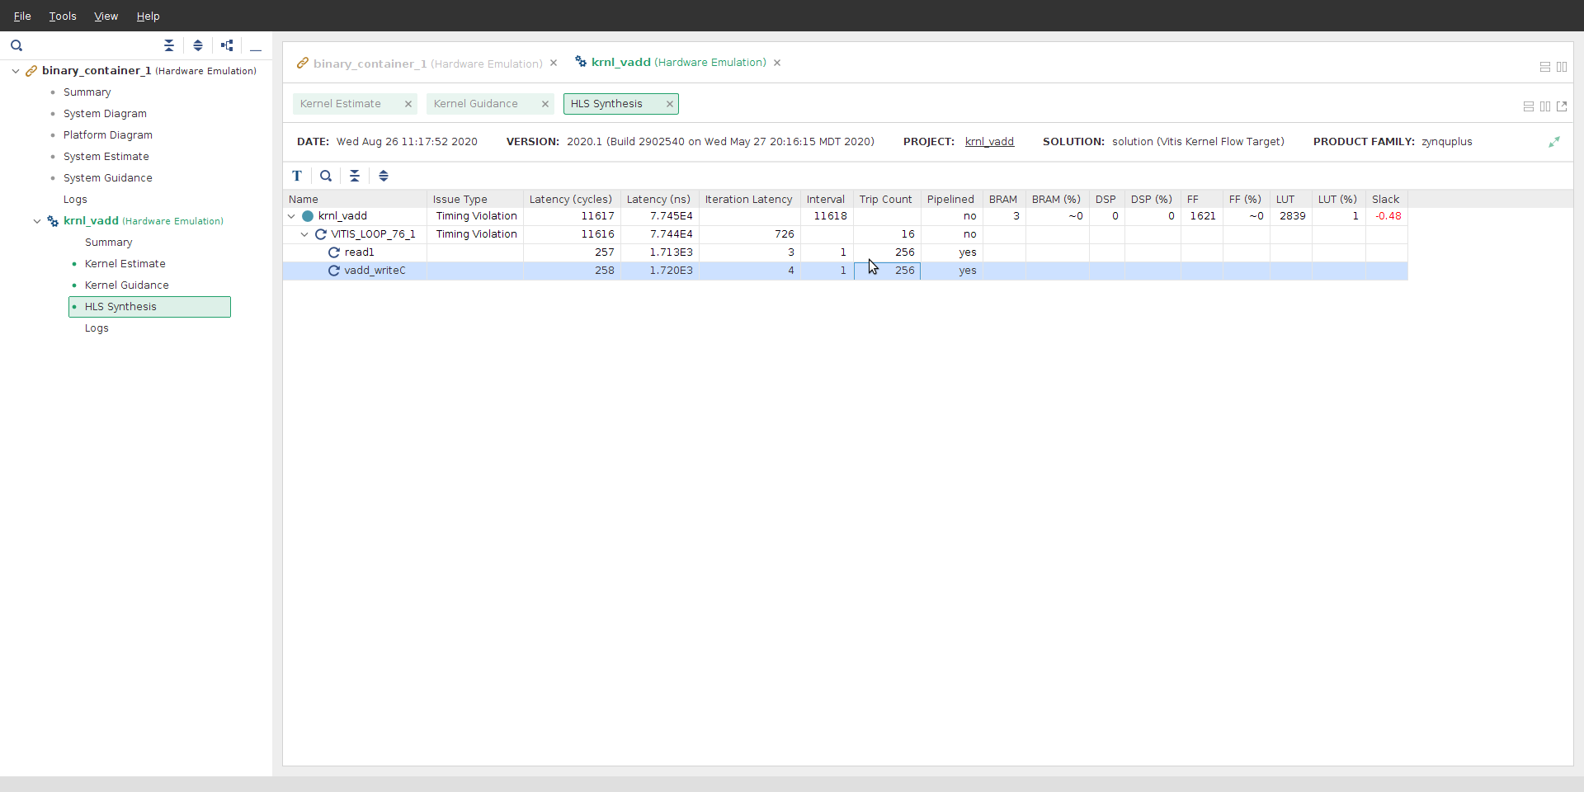
Lab 1: Understanding Vitis Project creation & Flow
Lab 1
Step 24 – Click on HLS Synthesis, this will show the performance of the accelerator, close the Vitis Analyser

Slide 42
Lab 1: Understanding Vitis Project creation & Flow
Lab 1
Step 24 – Right Click on the krnl_vadd under the Assistant view and launch Vitis HLS.

Slide 43
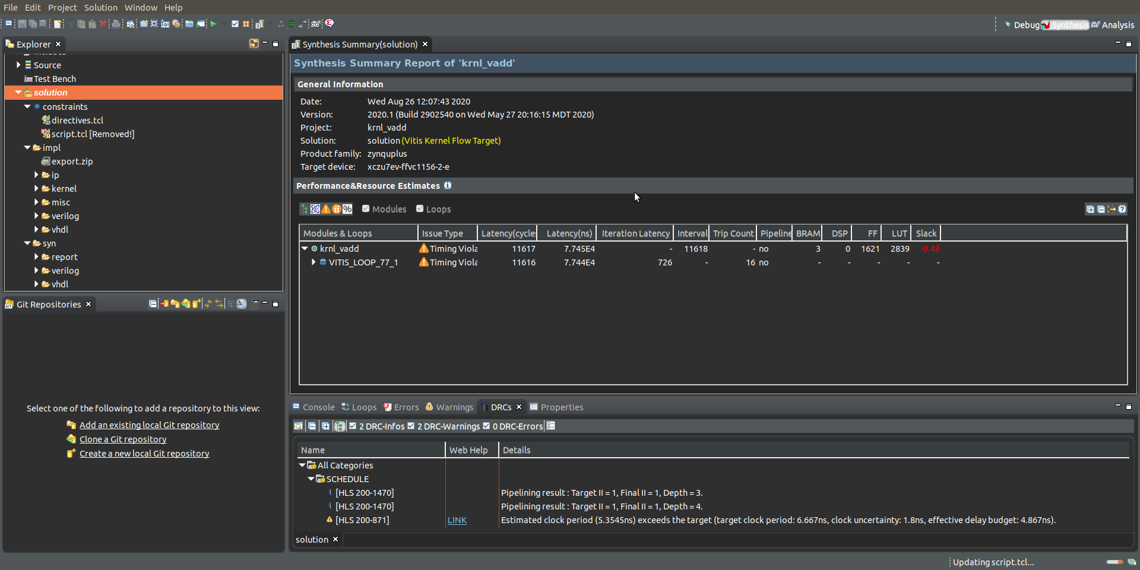
Lab 1: Understanding Vitis Project creation & Flow
Lab 1
Step 24 – This will open Vitis HLS project, click on Analysis View.

Slide 44
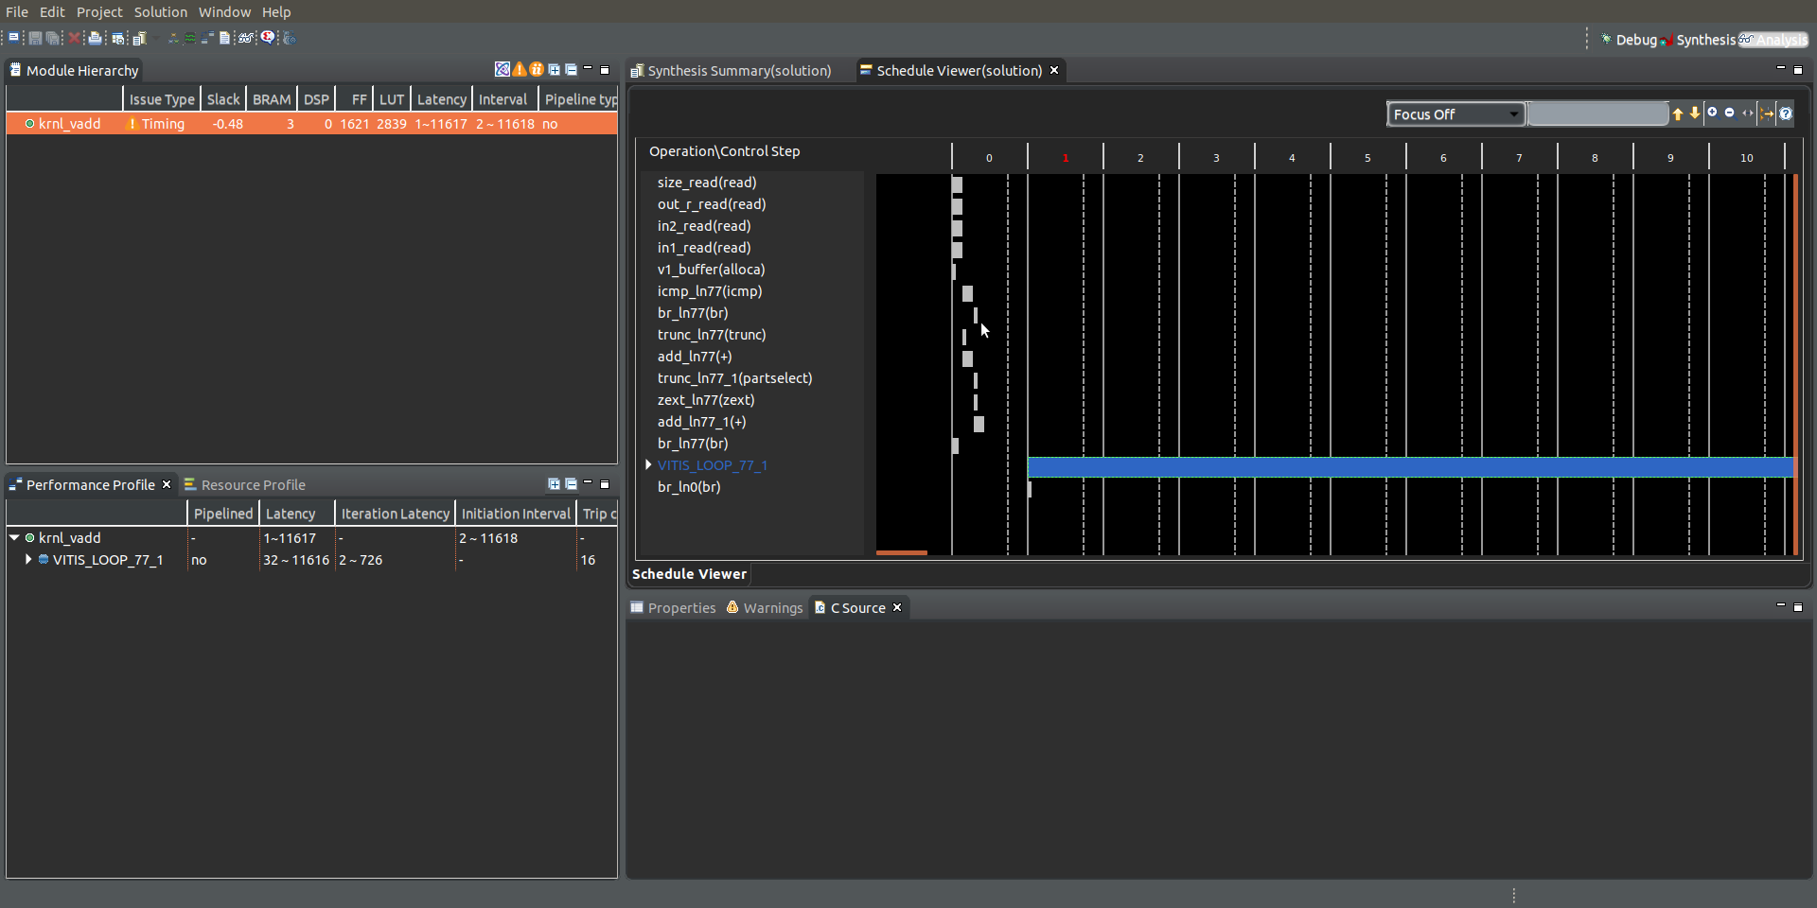
Lab 1: Understanding Vitis Project creation & Flow
Lab 1
Step 24 – This will open the schedule viewer; it is in this view we can cross probe to the C/C++ and determine what the bottle necks if any are. Explore the Analysis view then switch back the Synthesis View

Slide 45
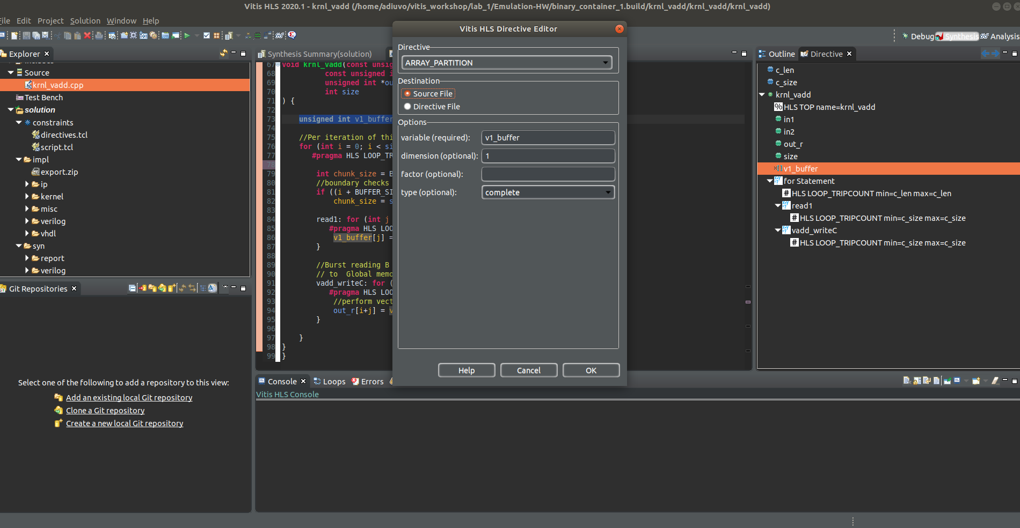
Lab 1: Understanding Vitis Project creation & Flow
Lab 1
Step 24 – If we want to add any optimizations, we can use the directive tab, double click on an element and then use the directive editor to add them to the source code. Explore the optimizations but click cancel and close Vitis HLS

Slide 46
Lab 1: Understanding Vitis Project creation & Flow
Lab 1
Step 24 – Back in Vitis, if we had made any changes in Vitis HLS we would need to rebuild the project.

Slide 47
Lab 1 Summary
Lab 1 Summary
The concludes lab 1, throughout this lab we have demonstrated
How to Open Vitis
How to create a project
How to Build & Debug a SW Emulation Flow – Including Breakpoints and Single Stepping
How to Build & Debug a HW Emulation Flow – Including Waveform
How to Examine the Vitis Analysis Report
How to work with accelerators kernels in Vitis HLS and Analyze bottle necks and add in pragma for optimizations.

Slide 48
Lab 2 Instantiating Xilinx Deep Learning Processor

Slide 49
Lab 2: Instantiating Xilinx Deep Learning Processor
Lab 2
Step 1 – Minimize the Lab_1_system project

Slide 50
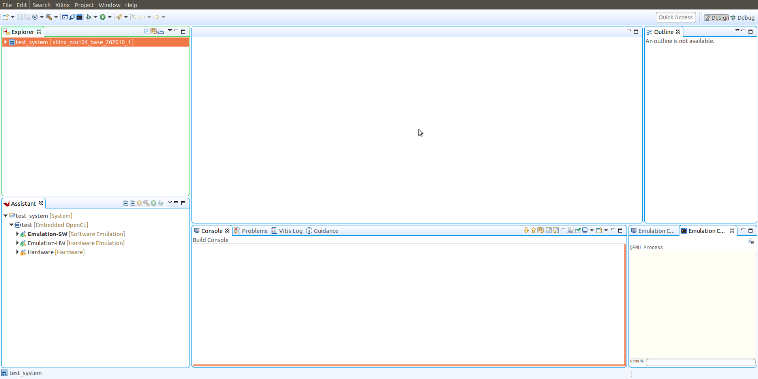
Lab 2: Instantiating Xilinx Deep Learning Processor
Lab 2
Step 2 – Click and create a new application project

Slide 51
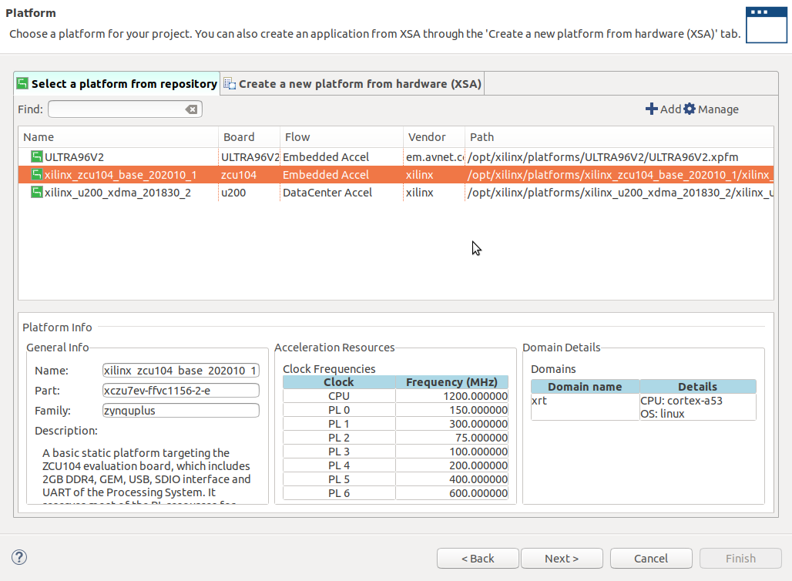
Lab 2: Instantiating Xilinx Deep Learning Processor
Lab 2
Step 3 – Select the platform you desire – for this example ZCU104 and click next

Slide 52
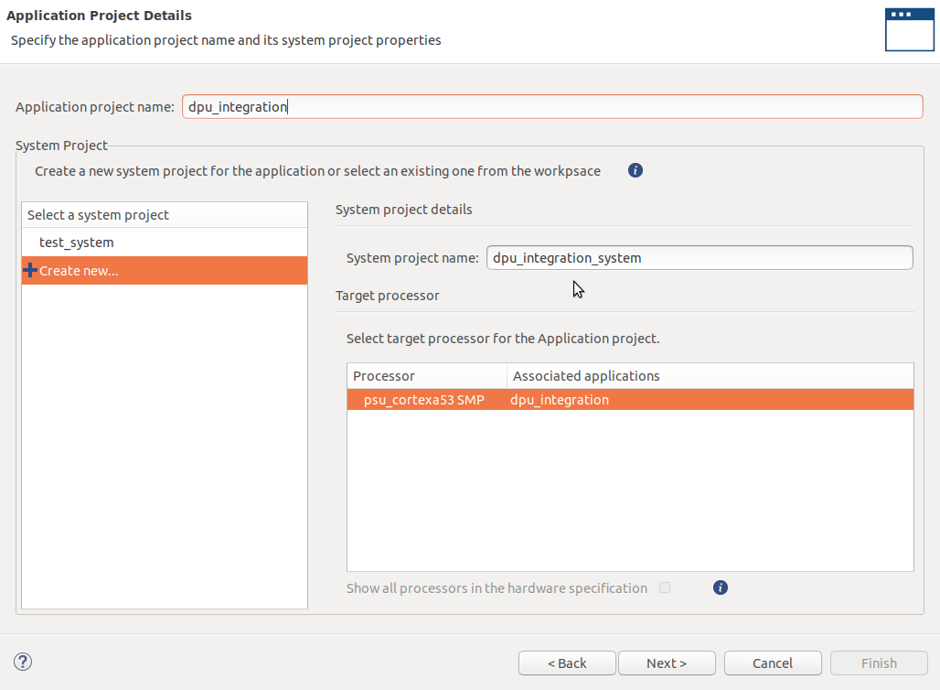
Lab 2: Instantiating Xilinx Deep Learning Processor
Lab 2
Step 4 – Enter a project name and click next

Slide 53
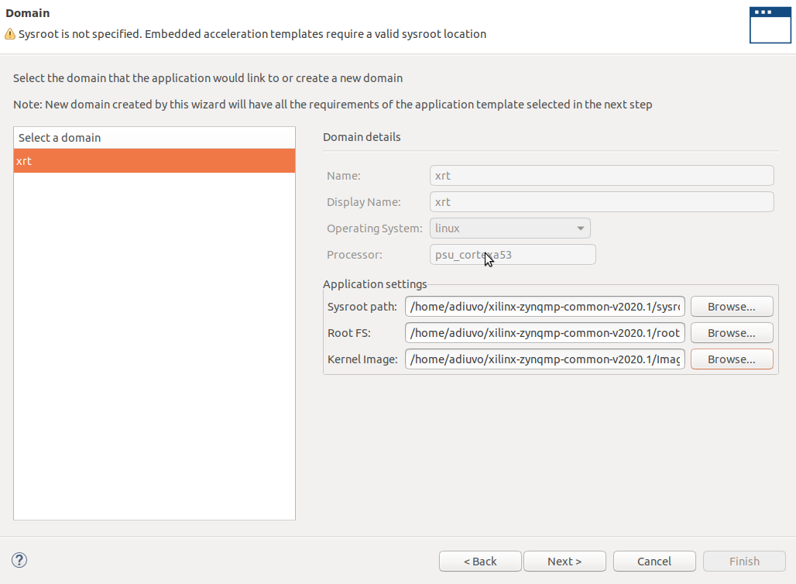
Lab 2: Instantiating Xilinx Deep Learning Processor
Lab 2
Step 5 – Enter the location of the SYSROOT, RootFS and Kernel Image

Slide 54
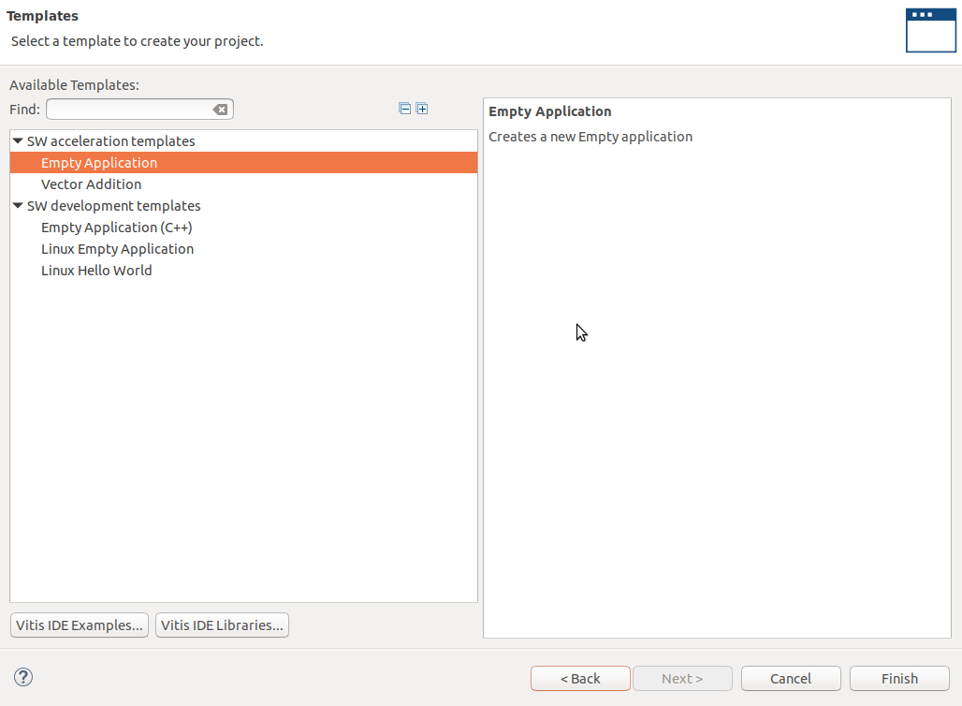
Lab 2: Instantiating Xilinx Deep Learning Processor
Lab 2
Step 6 – Select Empty Application and click on finish

Slide 55
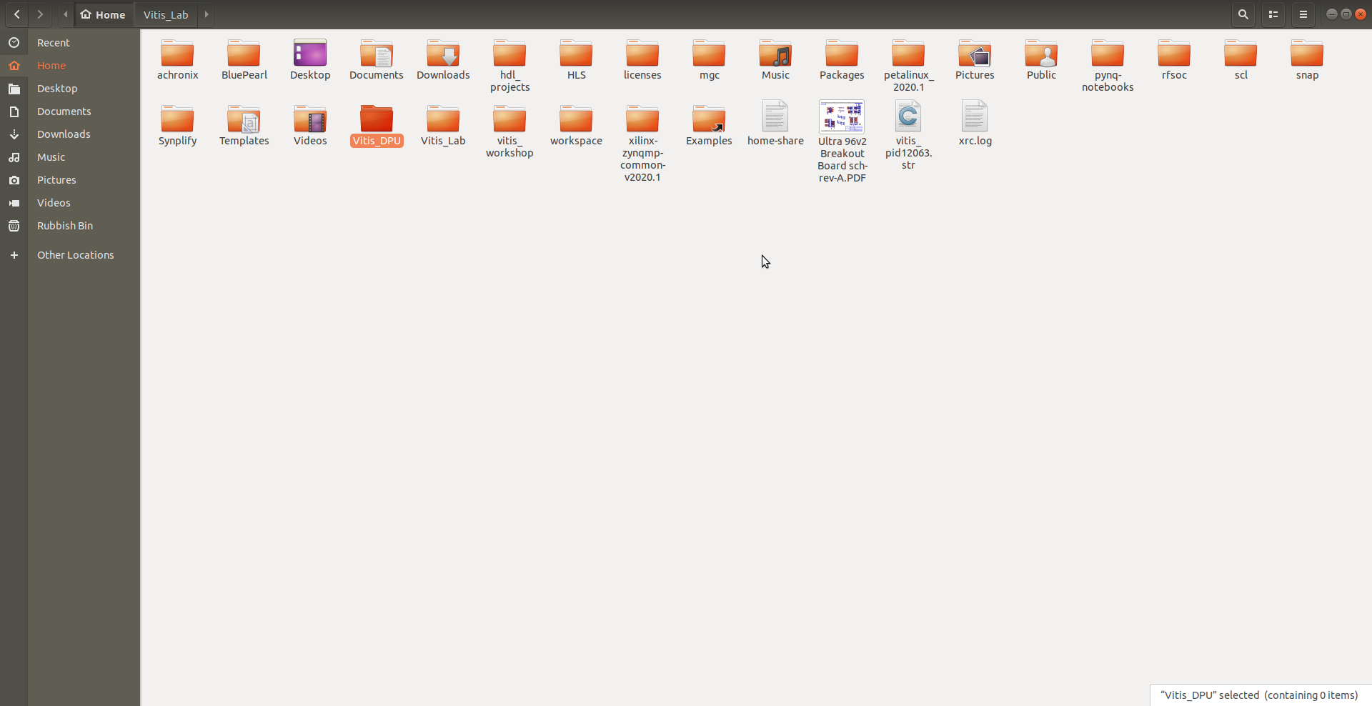
Lab 2: Instantiating Xilinx Deep Learning Processor
Lab 2
Step 7 – Create a new directory in your preferred directory – for example Vitis_DPU

Slide 56
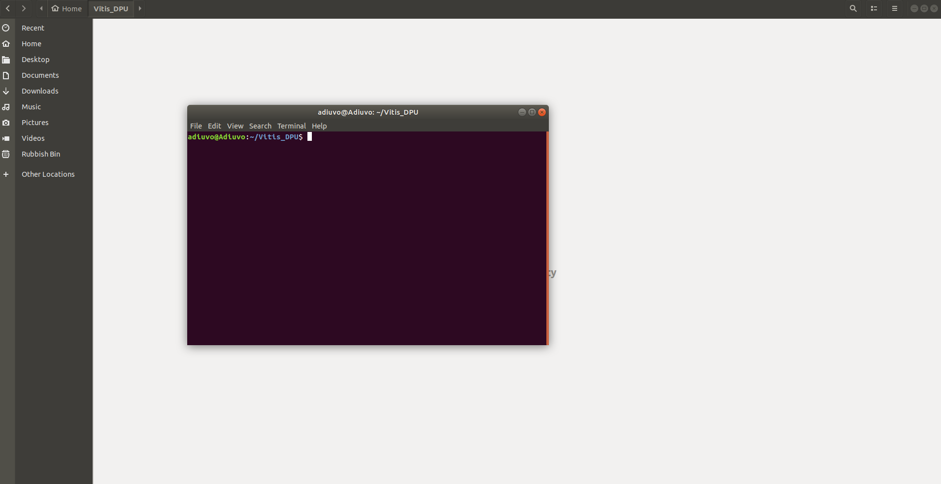
Lab 2: Instantiating Xilinx Deep Learning Processor
Lab 2
Step 8 – Change directory into the new folder – Open a new terminal in that folder

Slide 57
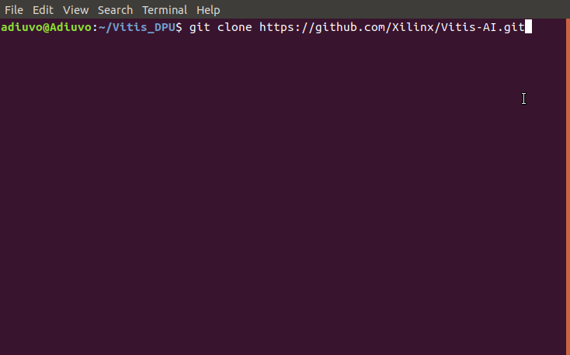
Lab 2: Instantiating Xilinx Deep Learning Processor
Lab 2
Step 9 – Clone the Vitis-AI github with the command
git clone https://github.com/Xilinx/Vitis-AI.git

Slide 58
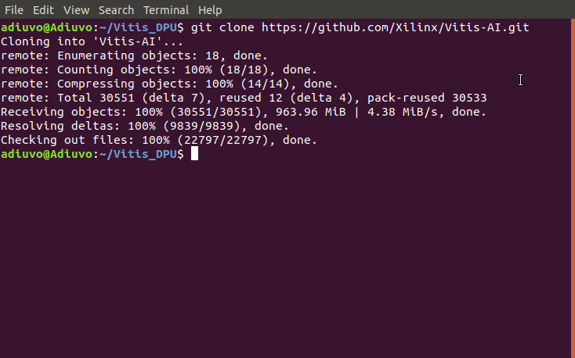
Lab 2: Instantiating Xilinx Deep Learning Processor
Lab 2
Step 10 – This will clone the Vitis-AI tool

Slide 59
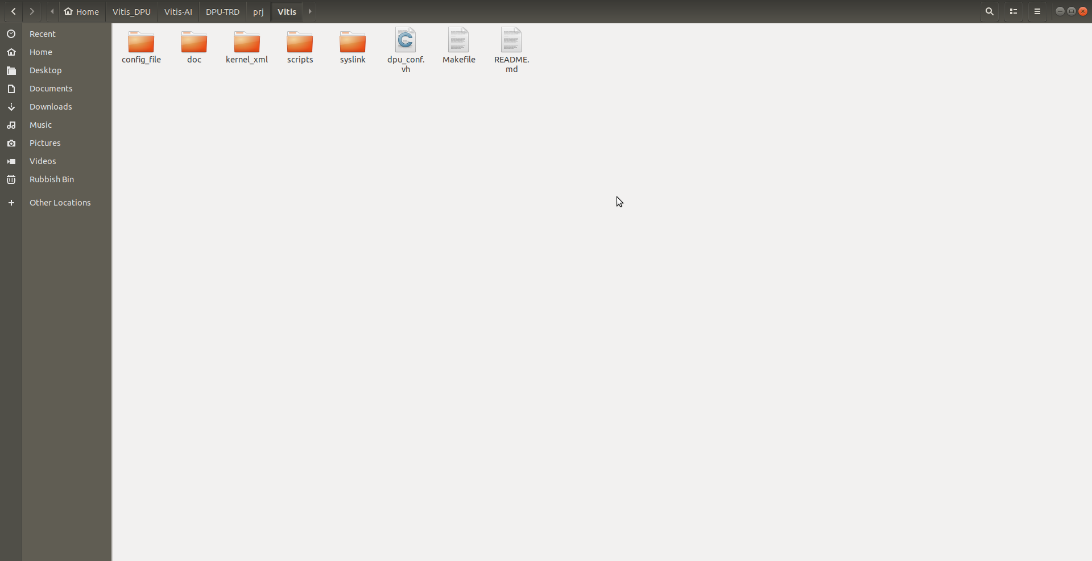
Lab 2: Instantiating Xilinx Deep Learning Processor
Lab 2
Step 11 – Change directory into the Vitis-AI/DPU-TRD/prj/Vitis and open dpu_conf.vh

Slide 60
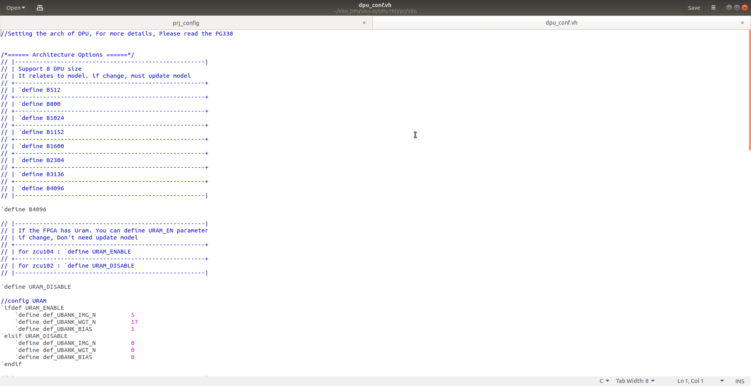
Lab 2: Instantiating Xilinx Deep Learning Processor
Lab 2
Step 12 – to configure the DPU we use dpu_conf.vh – examine the file and close it

Slide 61
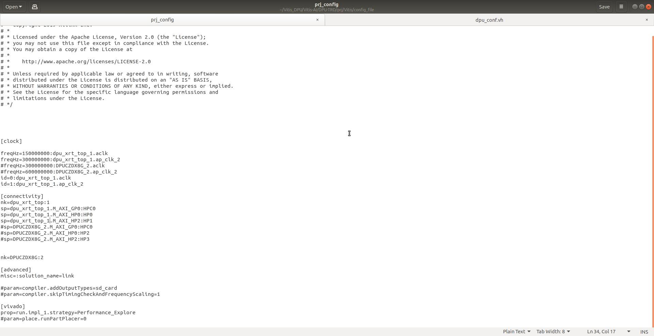
Lab 2: Instantiating Xilinx Deep Learning Processor
Lab 2
Step 13 – Change directory to the config_file open the file prj_config for editing – update the file to be as shown below

Slide 62
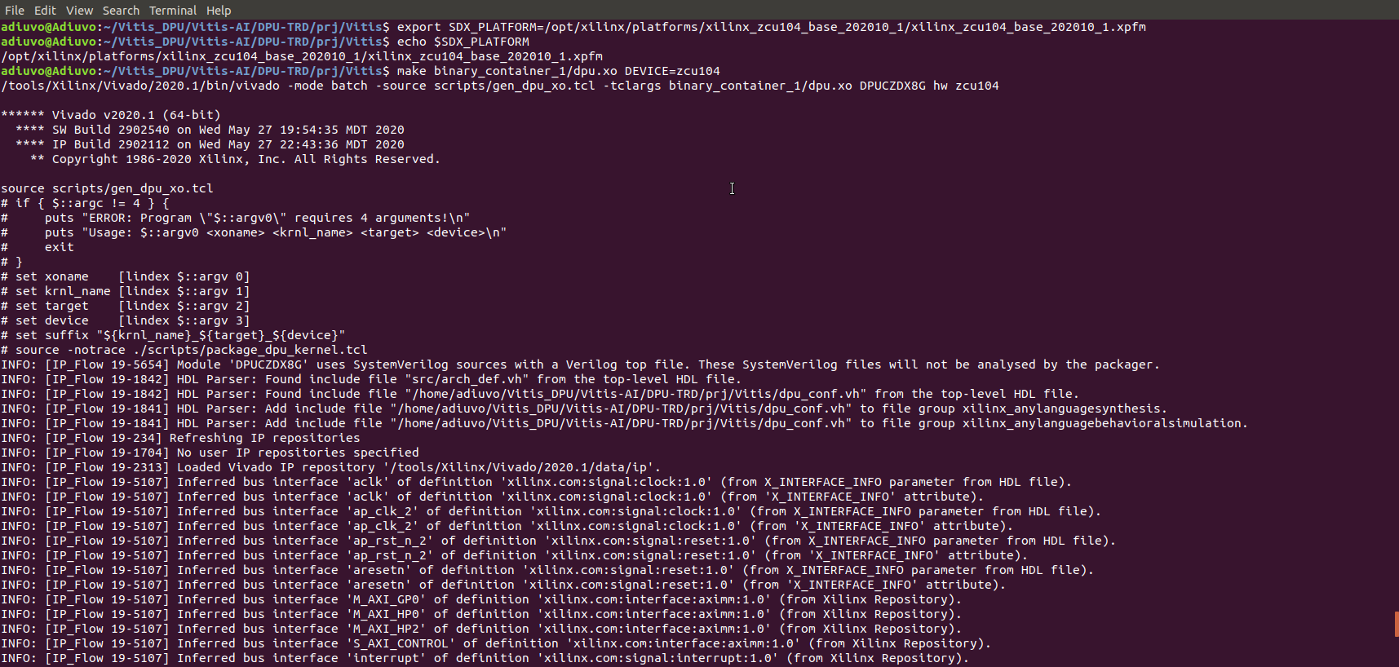
Lab 2: Instantiating Xilinx Deep Learning Processor
Lab 2
Step 14 – In the terminal window export the platform location and make the XO
export SDX_PLATFORM=<location>
make binary_container_1/dpu.xo DEVICE=zcu104

Slide 63
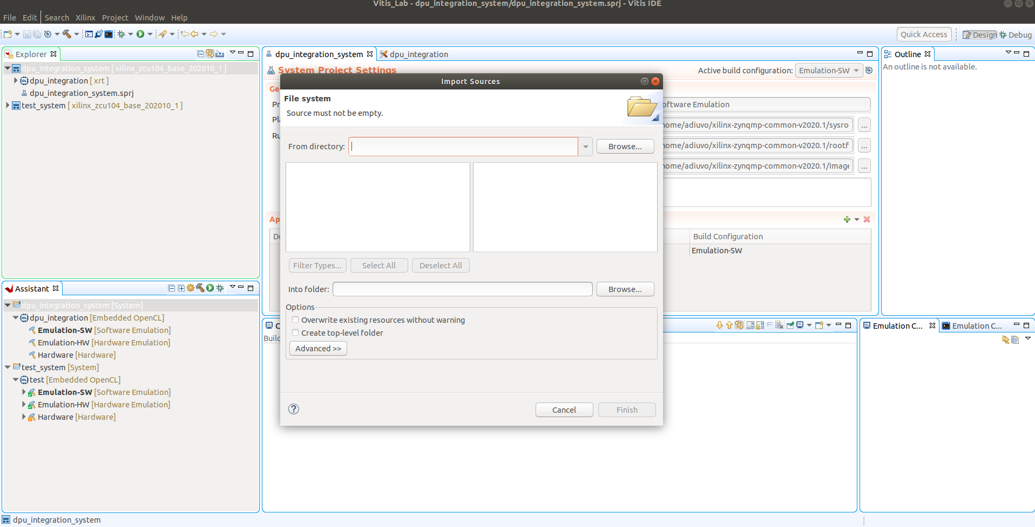
Lab 2: Instantiating Xilinx Deep Learning Processor
Lab 2
Step 15 – Back in Vitis, click on the src folder in the project, right click and select import sources

Slide 64
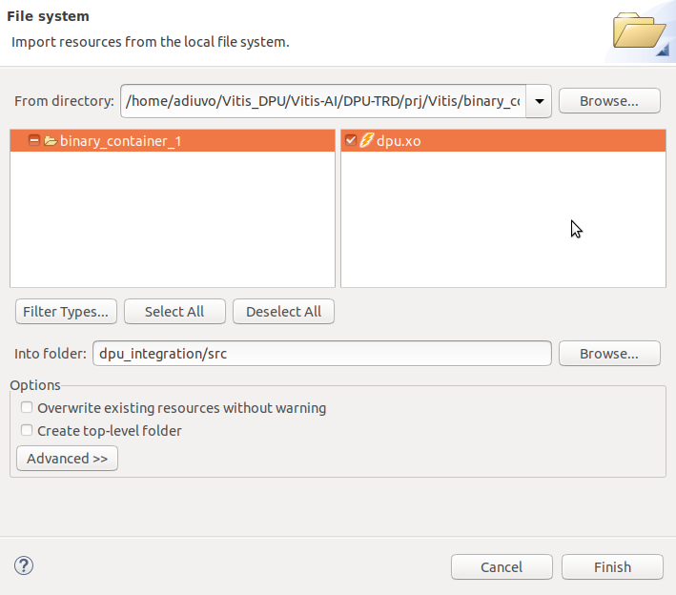
Lab 2: Instantiating Xilinx Deep Learning Processor
Lab 2
Step 16 – Navigate to the Vitis-AI directory and the binary_container_1 folder. Select the DPU.xo and click finish

Slide 65
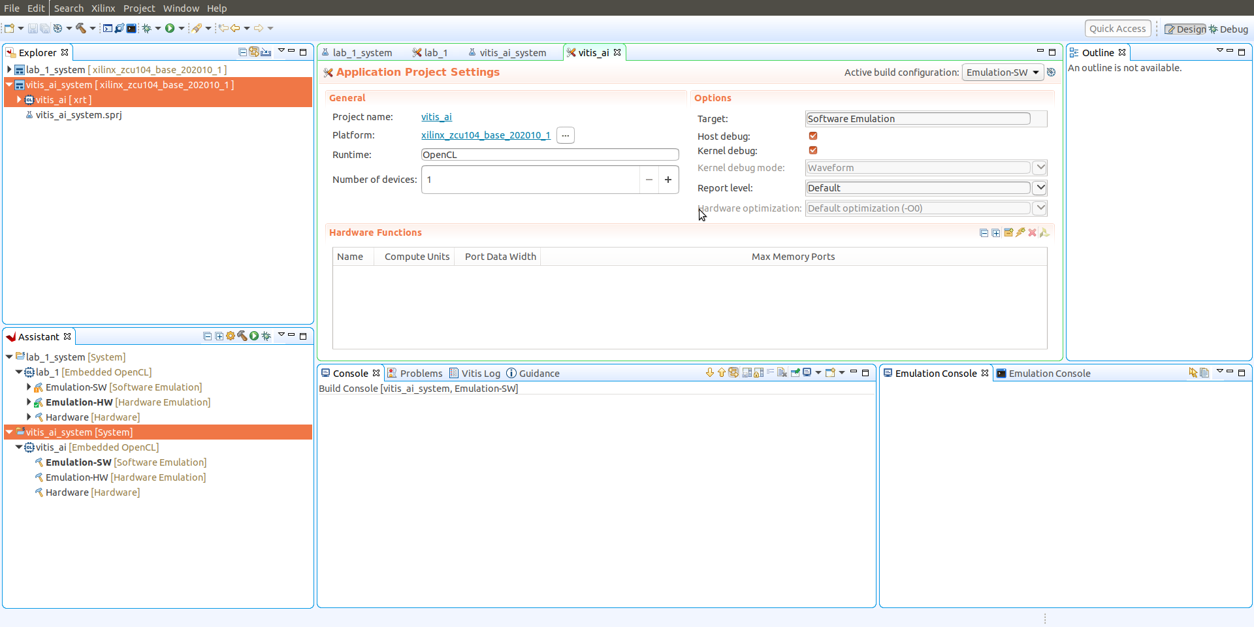
Lab 2: Instantiating Xilinx Deep Learning Processor
Lab 2
Step 17 – Click on the lightening bolt icon to select the function to accelerate to hardware

Slide 66

Lab 2: Instantiating Xilinx Deep Learning Processor
Lab 2
Step 18 – Select the DPU function from the list of matching items

Slide 67

Lab 2: Instantiating Xilinx Deep Learning Processor
Lab 2
Step 19 – Click on build and the design will implement.

Slide 68
Lab 2: Instantiating Xilinx Deep Learning Processor
Lab 2
Step 20 – Once built, from the Xilinx Menu select Vivado integration and open Vivado project

Slide 69

Lab 2: Instantiating Xilinx Deep Learning Processor
Lab 2
Step 21 – Once Vivado opens, open the block diagram and you will see the DPU

Slide 70

Lab 2: Instantiating Xilinx Deep Learning Processor
Lab 2
Step 21 – With the DPU platform created, the HWH file is now created for use with the remaining Vitis-AI stack

Slide 71
Lab 2 Summary
Lab 1 Summary
The concludes lab 2, throughout this lab we have demonstrated
How to clone the Vitis-AI tools
Modify the DPU configuration
Create the DPU.Xo for use in Vitis bottom up flow
Import the DPU into Vitis
Build the Xclbin and HWH file – required for higher levels Vitis-AI stack
Explore the implemented design in Vivado

Slide 72
Further Support
Lab 1 Summary
The following resources may be of interest
https://www.adiuvoengineering.com/blog - Adiuvo engineering blog updated weekly
https://www.adiuvoengineering.com/microzed-chronicles-archive - Complete Adiuvo engineering blog backlog
https://github.com/Xilinx/Vitis-AI-Tutorials - Vitis AI Tutorials
https://www.hackster.io/AlbertaBeef/projects - Good source of Vitis AI Ultra96 projects

